Slide 1

Conference on Child and Youth Loneliness
Danish Embassy, London
13th March 2025
Pamela Qualter

Slide 2

Social Relationships
Matter
Professor Pamela Qualter
Notes:
Social relationships matter. Although we may require different amounts of social contact, as a species we all need others for survival. We all benefit from having others in whom we can trust, and with whom we feel secure; we need to know that there are people who are on our side during difficult times. Even superficial social encounters play an important role in stabilizing our social health. Social relationships help us cope with stressors, and when we don’t have them we see impacts on physical and mental health.
Way back in our evolutionary history, humans began interacting with each other to get what they needed for survival and reproduction. Other animals did the same thing, with members coming together for protection. That biological strategy was effective: nature selected in favour of animals who were motivated to be with other members of their species. In that context, being rejected by other members of their species represented a troublesome threat - once dependent on each other for basic needs, lives were put at risk when individuals were excluded from the group.
In our evolutionary history, we were exposed to those same kinds of threats - being on the periphery of our social group, being excluded by members of our tribe, put us at those kind of risks. And, while we may not have those same threats today, we still carry with us that need to be in social groups for survival. Humans have this powerful need to belong, developing close bonds with others. Our survival is threatened if we find ourselves alone in the world.
But, our lives are also enhanced through our close social bonds. Social relationships appear to offer more than just protection against dangerous predators: maintaining stable, close relationships with others of the same species increases longevity and contributes to better health. There is something unique and pleasurable about being in each others' company that increases well-being.
Because human are pretty clever, we have evolved not just to respond to actual social isolation and rejection, but also to a perception that we might be about to experience that!; Our larger brains and our social cognitive capabilities mean we can think about whether there are initial signs of potential future rejection. Loneliness is part of that evolutionary system.

Slide 3
What is
Loneliness?

Slide 4
Loneliness is
the subjective perception of social relationships being deficient in either quantity or quality
Notes:
Loneliness can be a distressing, uncomfortable, and even painful experience; it involves negative emotions, cognitions and behaviours that arise when an individual perceives a discrepancy between the social relationships they have and the social relationships that they want to have (Peplau & Perlman, 1982).
Our recent review of qualitative work with children and adolescents showed there are clear psychological features of loneliness that are experienced across all ages, with people describing loneliness in terms of feelings of a lack of meaningful connection and painful disconnection. We also highlighted variation in the descriptions and understanding of loneliness characterized by age, suggesting there are clear developmental changes - children did not refer to personality or social comparisons as predictors of loneliness, but adolescents and young adults did. Also, it was the case that most studies that included youth with ages 18 years and above included mention of the political or societal landscape as predicting loneliness; younger samples were much less likely to include reference to that.

Slide 5
Loneliness is Not
social isolation
solitude
Notes:
It is distinct from social isolation (an objective lack of relationships) and solitude (being alone but not necessarily lonely).

Slide 6
Chronic loneliness
has serious consequences
Notes:
Chronic loneliness (by that we mean occurs often and/or is of long duration) has very has serious health consequences, including cardiovascular risks, reduced longevity, and mental health issues.
Also linked to academic performance, career prospects and overall life outcomes.

Slide 7
Loneliness over time: Has loneliness been increasing over time?
Notes:
Despite popular narratives about a "loneliness epidemic," empirical evidence on whether loneliness is increasing over time is mixed.
Some studies suggest loneliness has remained stable over the past decades. Others indicate age-related variations, with young adults reporting increased loneliness in recent years. Maybe that change is to do with cultural shifts have influenced how people report loneliness (e.g., decreased stigma leading to more self-reports).

Slide 8
Loneliness is an aversive state across the lifespan
Children as young as 5 years of age offer valid definitions of loneliness.
Children offer clear ways of coping with loneliness, reporting a need to connect with others, sometimes physically and sometimes mentally.
Loneliness is associated with negative and uncomfortable emotions across all ages.
Loneliness motivates people across the life course to connect with others.

Slide 9
Loneliness is adaptive
Notes:
Notion that loneliness is adaptive is crucial when we want to move to think about interventions. Loneliness, sometimes, is ‘food for us’, but loneliness experienced frequently or for long periods of time is related to poorer outcomes. Also, intensity of that experience matters. So, it’s chronic loneliness that is important.

Slide 10
Age-related Changes in Loneliness
it is stable, but low, from age 7 to 12 years
it peeks during early adolescence and then very slowly decreases until early adulthood
is stable during adulthood, but increases at oldest old age (i.e., 85 years and older)
Notes:
Talked already that there isn’t necessarily an epidemic of loneliness; we have simply become aware of it as being an issue and many more researchers are exploring it, many more nations are seeing it as an issue, and people are reporting it more openly.
What do we know about loneliness across the lifespan? Differences sources of loneliness, in adolescence, a number of risk factors emerge that challenge our social standing in the peer group and impact friendship - finding one’s identity for example ... also there's the appearance of romantic relationships as a source of loneliness.
In older age, a number of specific risk factors for loneliness also emerge and those factors pose challenges to established romantic relationships, such as losing a partner, reduced social activities because of increased physical disability and poor health (Dykstra, Van Tilburg, & De Jong Gierveld, 2005), and being confronted with a partner’s increasing frailty (Dykstra et al., 2005). Also, seeing those same challenges to friendships.

Slide 11
What affects loneliness during childhood and youth?

Slide 12
Cross-national differences in child and youth loneliness
Notes:
Cross-National Patterns
Loneliness is generally lower in Northern and Western Europe and higher in Southern and Eastern Europe. For adults and youth.
For youth, we found that the way a country’s culture—especially regarding hierarchy, social norms, and emotional expression—affects how lonely students feel.

Slide 13
Within country differences in child and youth loneliness

Slide 14
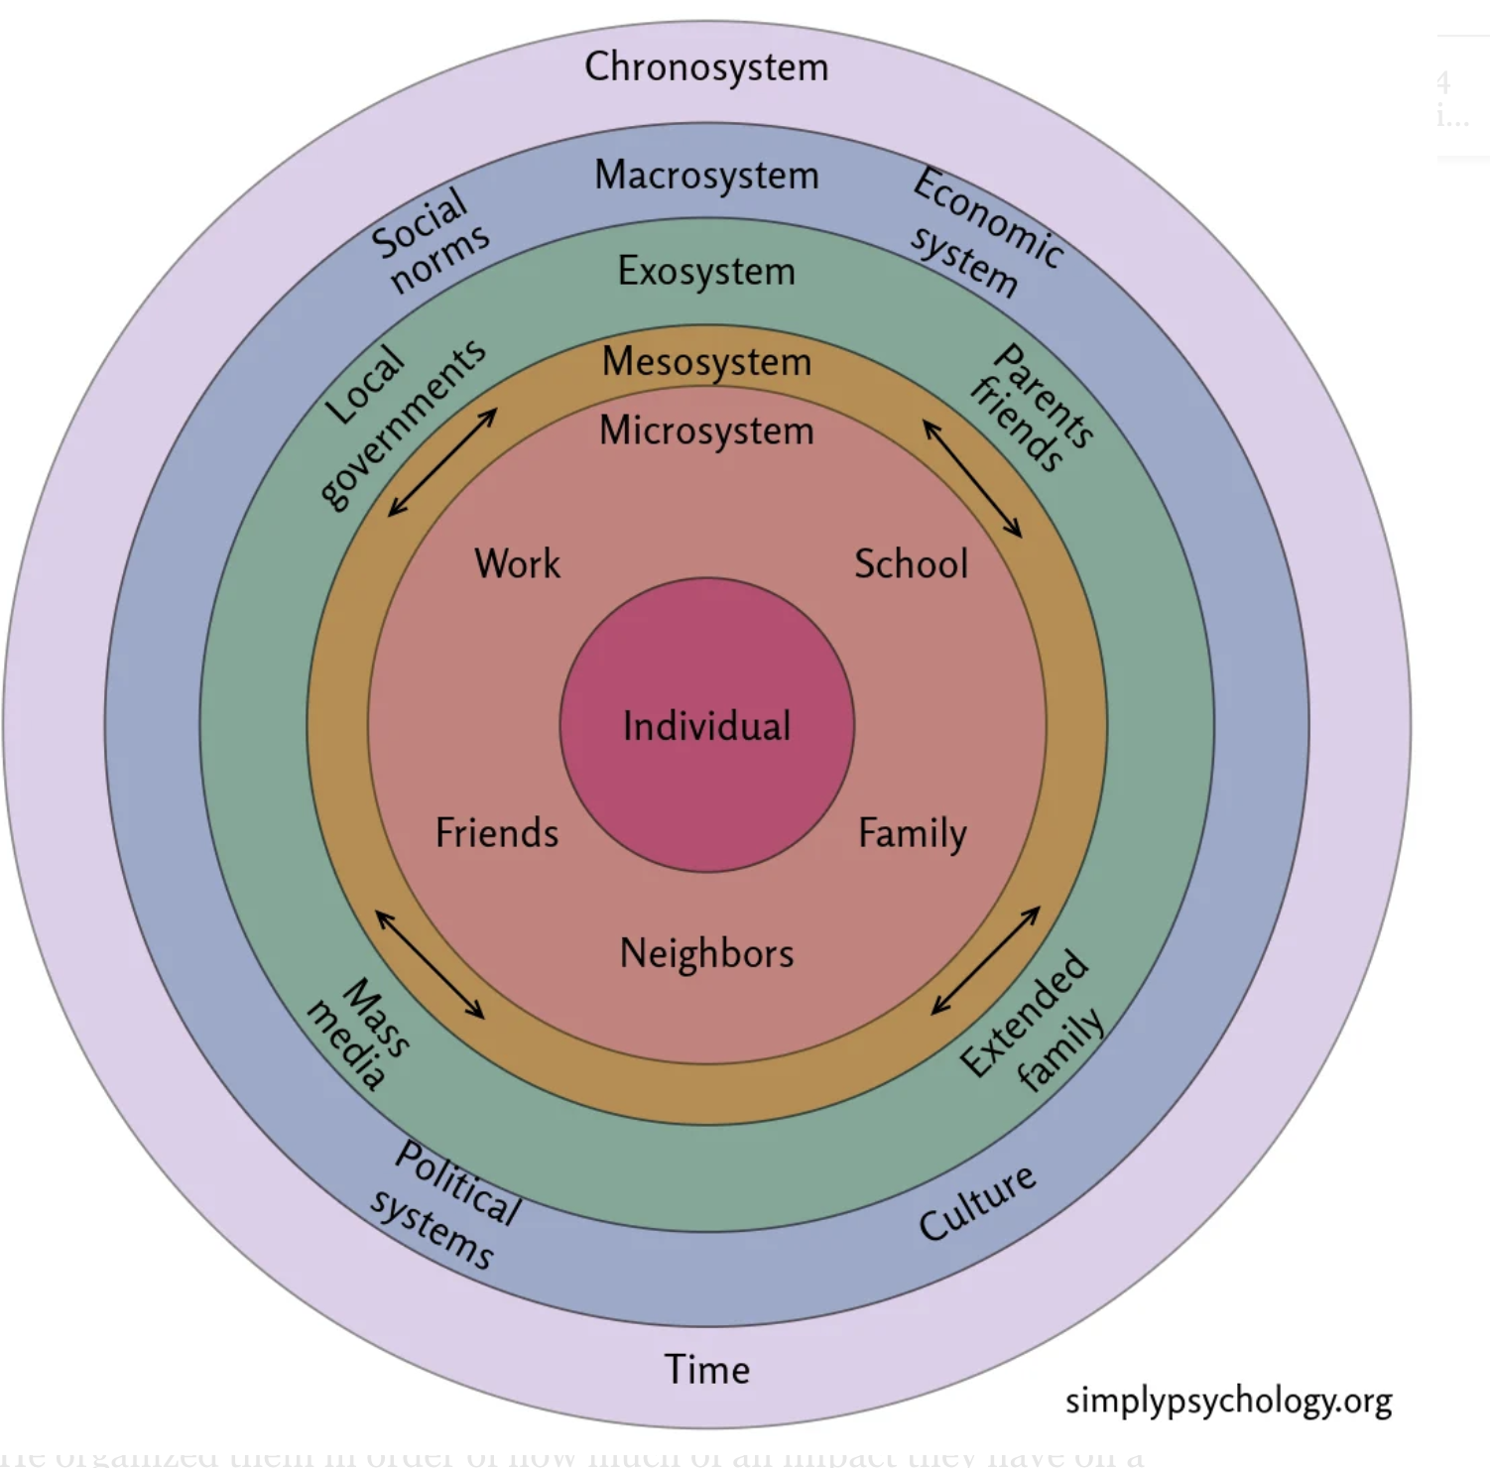
Notes:
Macro-Level Factors Affecting Loneliness
Within-Country Differences
Some studies suggest no major difference between urban and rural loneliness, while others find youth in remote areas more affected.
High social capital (trust, reciprocity, community engagement) reduces loneliness at the neighbourhood level.
Values and Norms
Individualism vs. Collectivism: Individualistic societies prioritize autonomy, which may lead to weaker social ties but lower stigma around loneliness.
Materialism and Political Climate: Societies with rising materialistic values and conservative social policies may see increased loneliness.
Family Lives
Declining marriage rates, increased divorce, and smaller household sizes can contribute to loneliness.
However, changing norms may reduce the negative impact of these factors.
School
A positive school climate, with supportive teachers and inclusive environments, helps reduce loneliness. Addressing loneliness in schools could improve academic success and overall well-being.
Technology and Digitalization
Social media has complex effects: it can facilitate social connection but also increase loneliness through online comparison and cyberbullying.
Increased residential mobility and migration can disrupt social networks, with immigration being an important predictor of loneliness among all age groups.
Living Conditions and Individual Resources
Economic inequality, poverty, and health issues are associated with higher loneliness. This has led many to argue that loneliness is a social justice issue that can only be addressed through systemic change.

Slide 15
My Final Point
Individual and macro-level change needs to happen to reduce population reports of chronic loneliness
Notes:
Implications for Public Policy
Both individual focused and macro-level change needs to happen to reduce reports of chronic loneliness.
Policy Recommendations:
Loneliness should be addressed at multiple levels, from improving social infrastructure to developing community-based (school-based) interventions.
Programmes targeting marginalized communities could be effective, but we shouldn’t focus on seeing them as ‘at risk’ because of individual characteristics, but because of they systemic structures that been they are marginalised.
Policies should be flexible and adaptable across different cultural contexts.

Slide 16
Questions? Contact me at pamela.qualter@mmanchester.ac.uk

