Slide 1


Conference on youth loneliness interventions and the role of society
Louise Solgård Hvas
Policy Advisor, Danish Red Cross Vice Chair, United Against Loneliness
Notes:
Remember to thank the Ambassador and Jakob’s team at the embassy for hosting this incredible event which I’ve really been looking forward to.

Slide 2
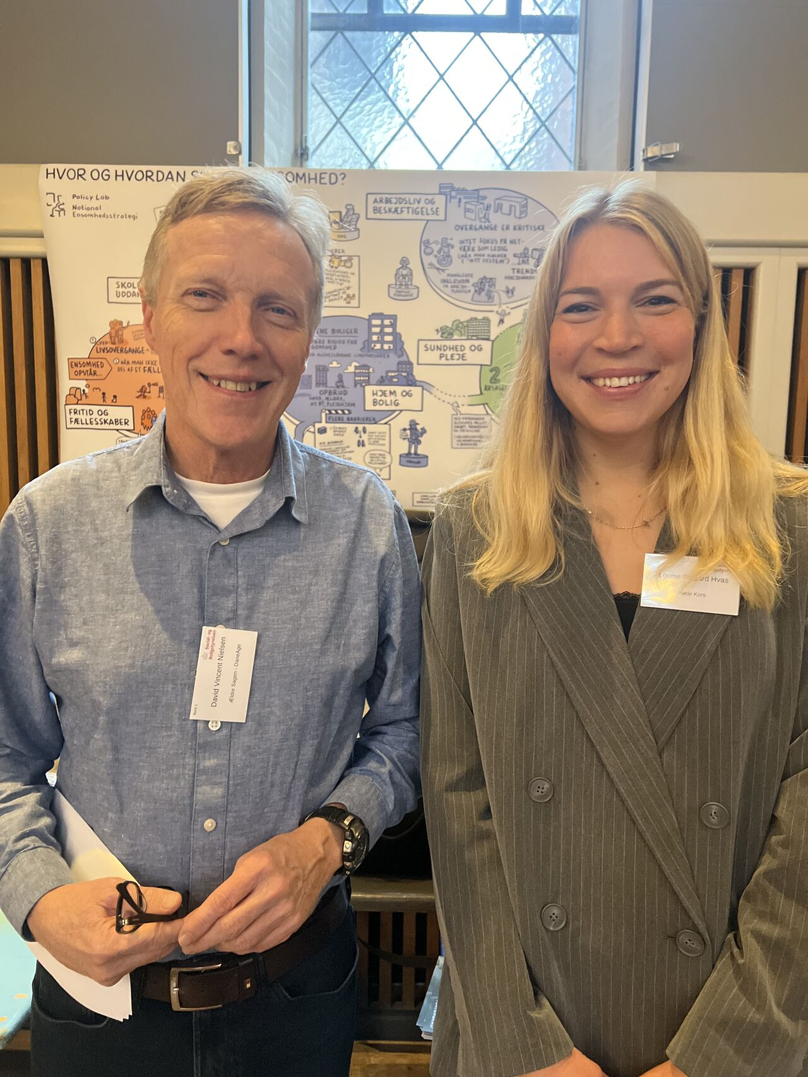
Introduction
Louise Solgård Hvas, loshv@rodekors.dk
Policy Advisor, Danish Red Cross, Vice Chair, Folkebevægelsen mod Ensomhed, United Against Loneliness
Co-author of Denmark’s first national strategy and action plan against loneliness
Political Science candidate from 2018, University of Copenhagen
Used to be a civil servant (2018-2022) within the Danish Ministry for Children and Education and the Ministry for Social Affairs

Slide 3
What will I be covering?
What is United Against Loneliness?
The road towards a national strategy against loneliness in Denmark
Promising activities and interventions that combat loneliness

Slide 4
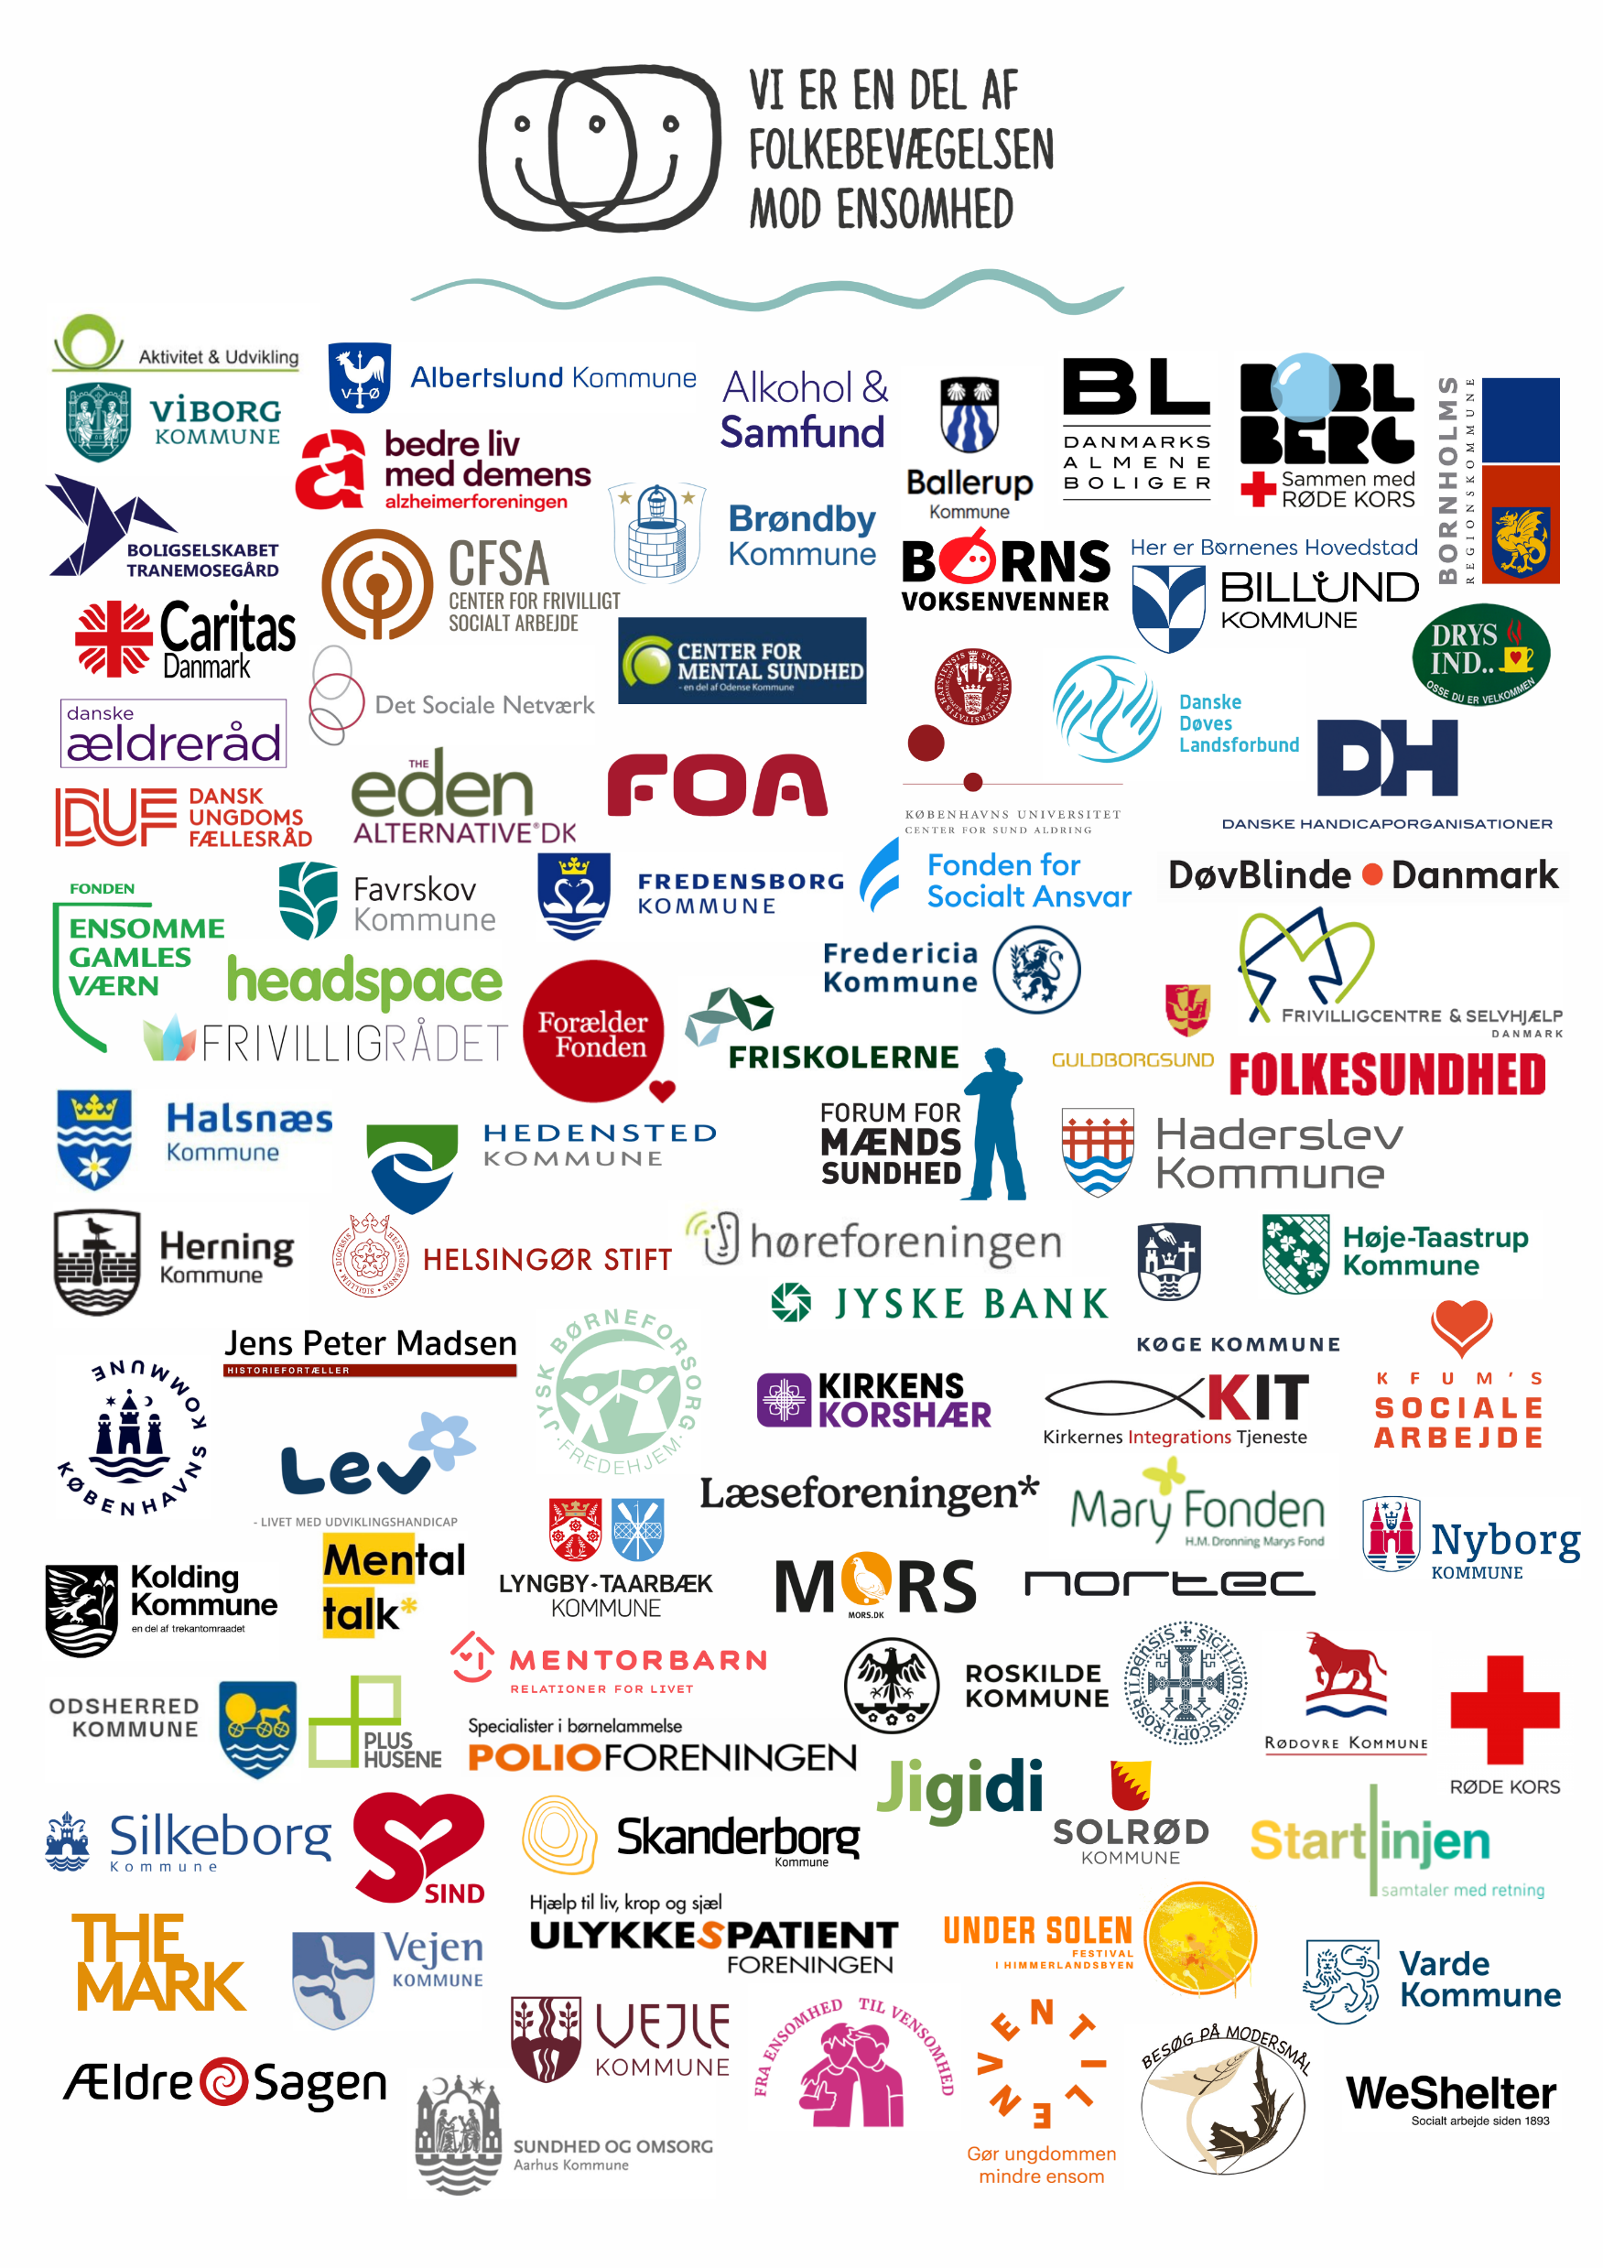
What is ”United Against Loneliness”, or Folkebevægelsen mod Ensomhed?
FME is an “umbrella organisation” that unites all actors that combat loneliness in Denmark – through all age groups
Formed in 2014 – funded solely by membership organisations until last year – which was the first year we received state funding
Consists of 90 organisations – civil society organisations, municipalities*, companies – even the Church is a member!
We post a monthly newsletter covering newest research, new promising initiatives etc; we host an annual national conference on loneliness; try to consolidate and unite advocacy efforts related to the Danish Parliament, etc
Currently, we collaborate with the National Directorate of Social Affairs on a national campaign against loneliness →
Notes:
What it means that we a an umbrella organisation? It means that our job is to inspire, communicate, share research and practicioner’s knowledge. And that we don’t initiate new things that our member organizations do already. A great example is Ventilen’s work that we just heard about. Because Ventilen already does an amazing job in combating loneliness amongst young people, our job is not to co-create what they’re already doing – it’s to make sure that Ventilen’s practical experience is shared with as many actors and agencies as possible, the municipalities is a great example.
It was created in 2014 because we saw that there was a need to bring all actors that already were working on this agenda, together.
What we really see is great is that FME is a place where municipalities and civil society organisations can learn from each other and get to know of each other’s initiatives – that is really important.

Slide 5
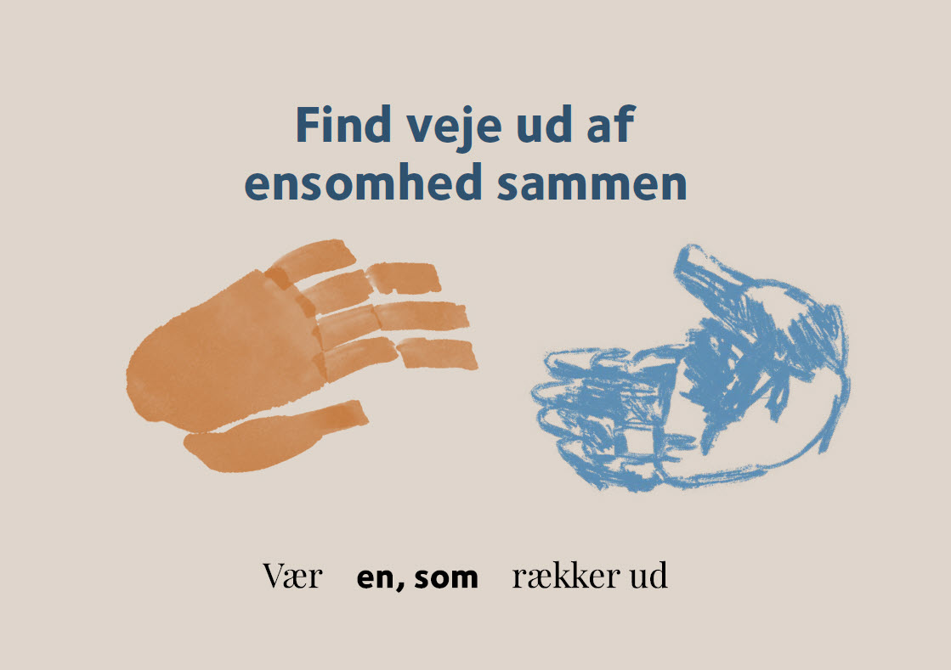

Slide 6

…and lastly, United Against Loneliness now follows the implementation of Denmark’s national strategy against loneliness
Covid-19 ‘paved the way’ for the loneliness agenda in Denmark – with the huge increase in (especially young) people who felt severely lonely. DRC and Dane Age pushed the agenda for several years.
→ We were inspired (a lot!) by the British Red Cross and the British loneliness strategy
In 2021, almost all the parties in Parliament decided that Denmark should have its first national strategy against loneliness – and that Danish Red Cross and DaneAge should facilitate the work.
Notes:
One of the reasons why the Red Cross together with Dane Age association was given the job to structure the national partnership and write the strategy was because both our organisations have a long history of combating loneliness through our national activities. In DRC, our oldest loneliness intervention actually turns 50 this year!

Slide 7
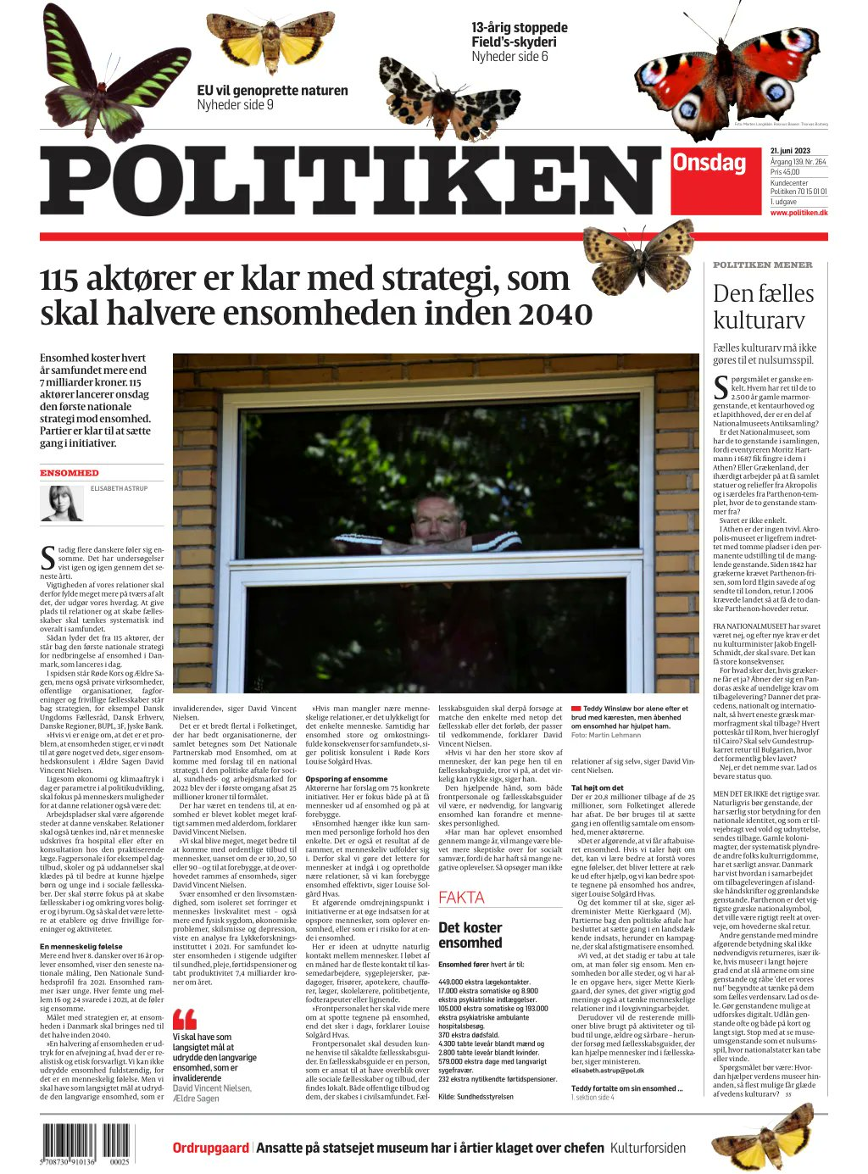
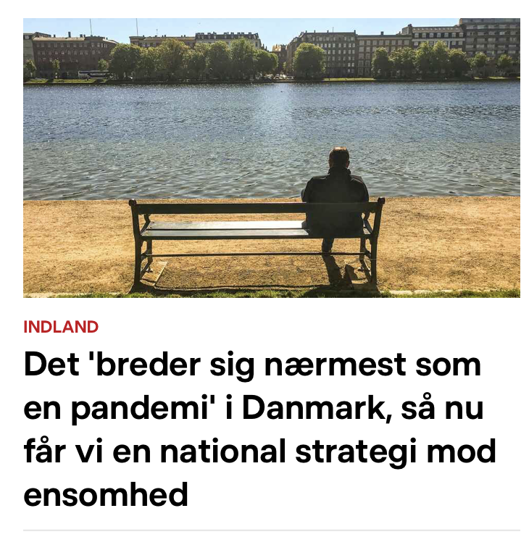
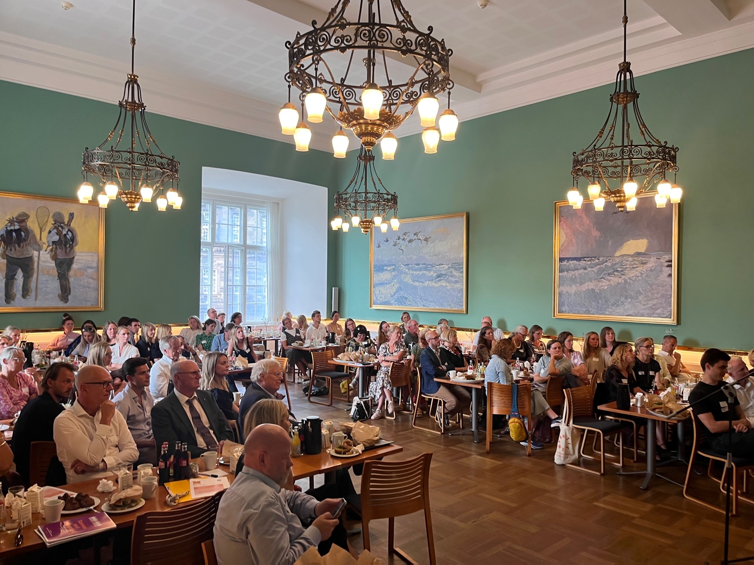
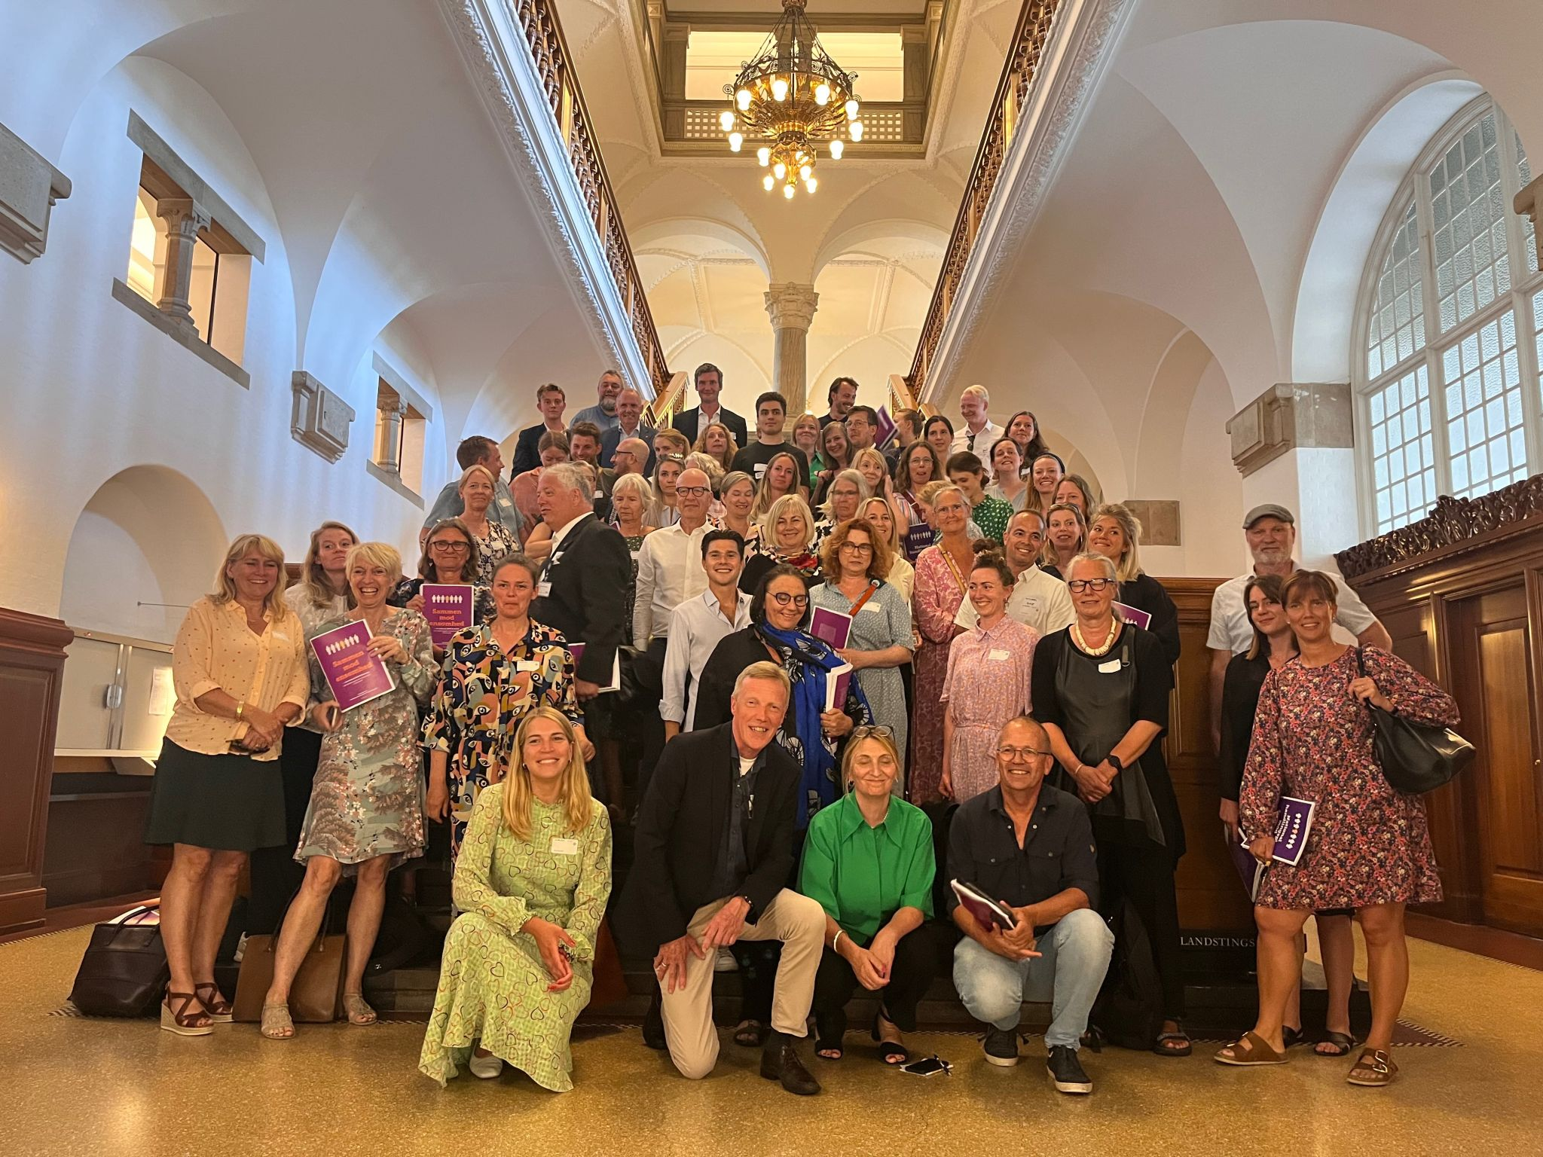
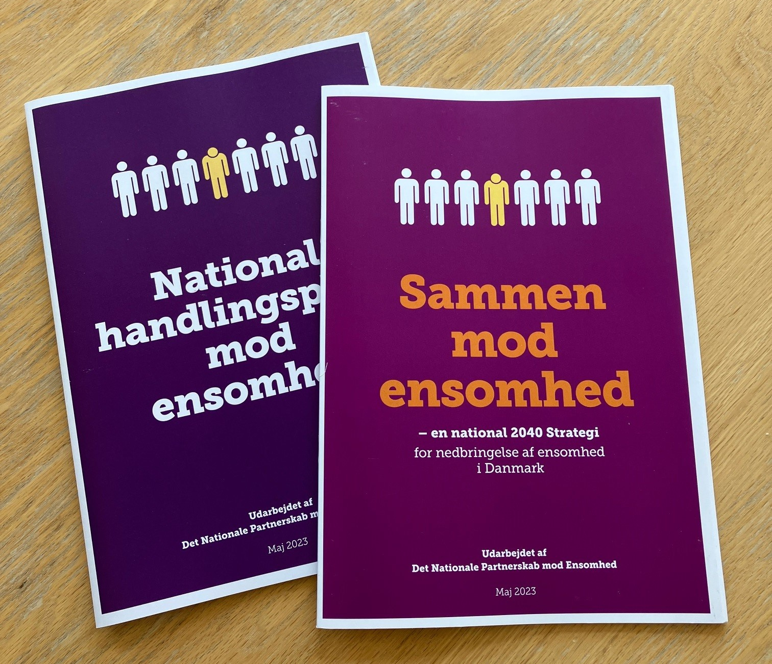
That’s how the national strategy with 75 concrete points to action was formed
Notes:
In a partnership with no less than 115 different organisations, spanning civil society organisations, the private sector, the health sector, education sector, the church, municipalities, the unions, etc.

Slide 8
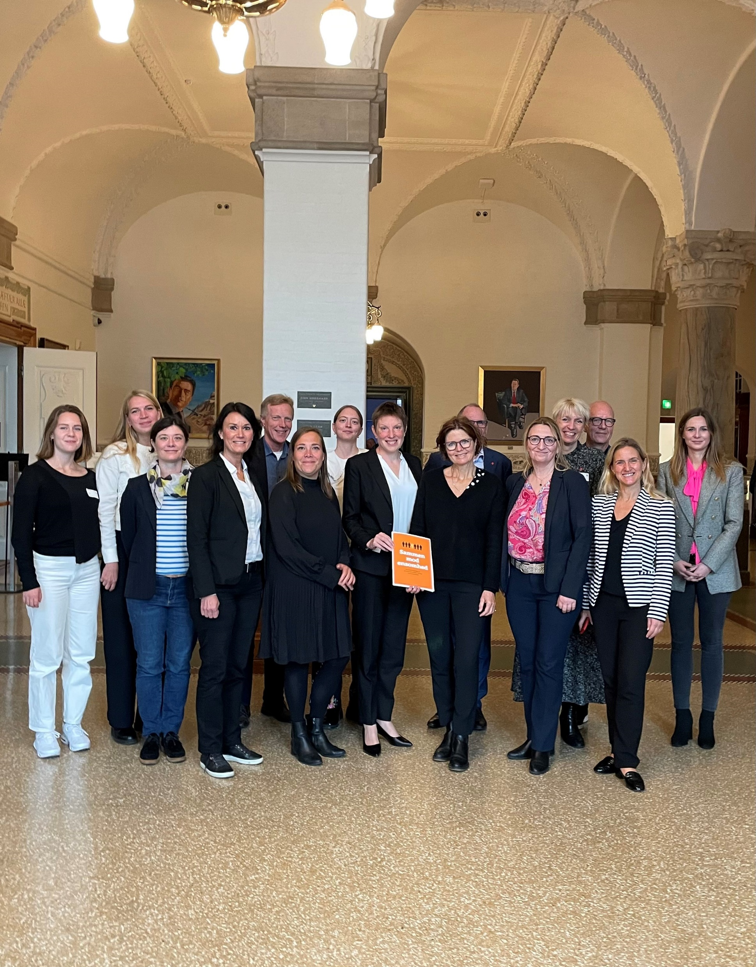
What is the strategy’s ambition?
Loneliness is not one’s own fault! And we need STRUCTURAL change to break the curve.
STRUCTURAL CHANGE of culture, rules and regulations, as well as behavior on a national, communal, and individual level
A NEW UNDERSTANDING: Meaningful relations and communities are the single most important factor determining our well-being and satisfaction with our lives – it should matter more to our politicians!
IT CALLS FOR POLITICAL CHANGE – amongst other things, an all-party parliamentary group on combating loneliness has been established – and 10 ministries was involved in the strategy process
A work for the long haul. The goal is that half as many people feel severely lonely in 2040 (4 pct as opposed to 8,4 pct of DK’s population)

Slide 9
Vi bygger videre

Slide 10
ACTIVITIES AND INTERVENTIONS AGAINST LONELINESS

Slide 11
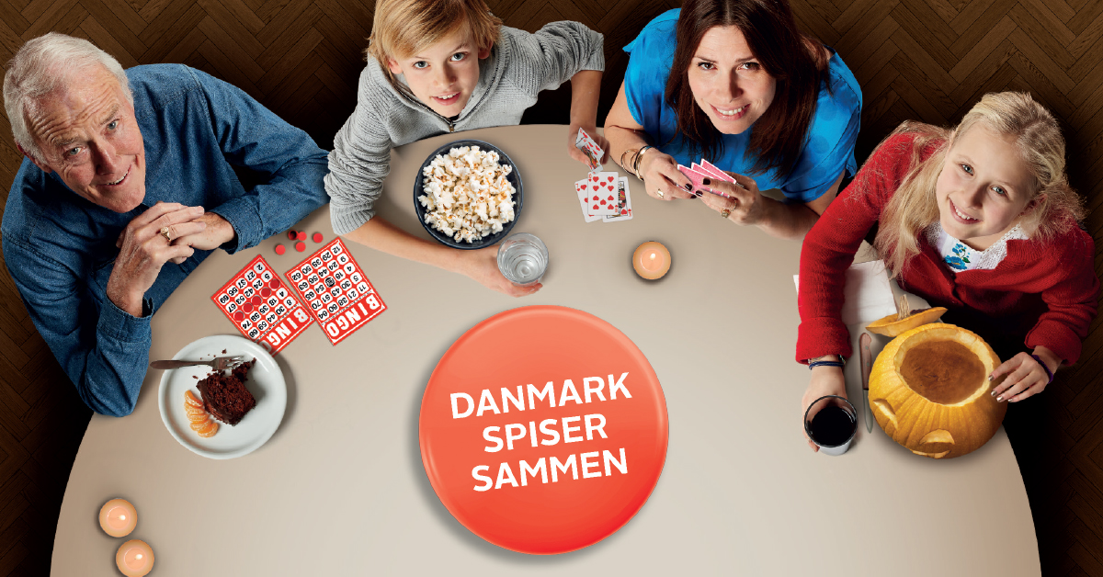
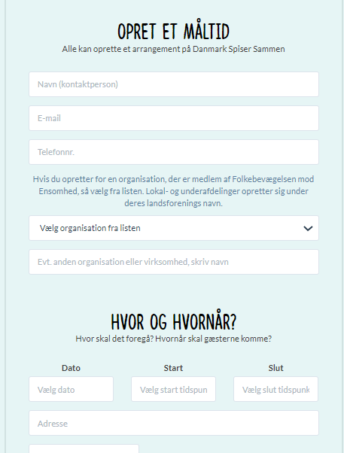
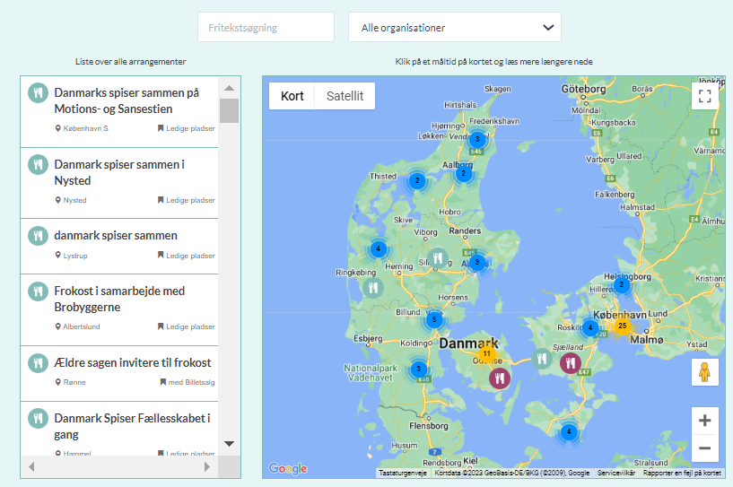
”Denmark dines together”
Week 17 (April) and 45 (Nov)
Everybody can initiate a communal dining activity (about 30,000 participate each year during these weeks)
A “happy” campaign addressing a “serious” subject (loneliness)
Promotes the feeling of “we are all in this together at the same time”
A communal dining activity has a focus on that we should all feel safe, seen and heard. And leave with a time and date for a new meeting, maybe with a stranger?
Notes:
One concrete initiative is Denmark dines together.

Slide 12
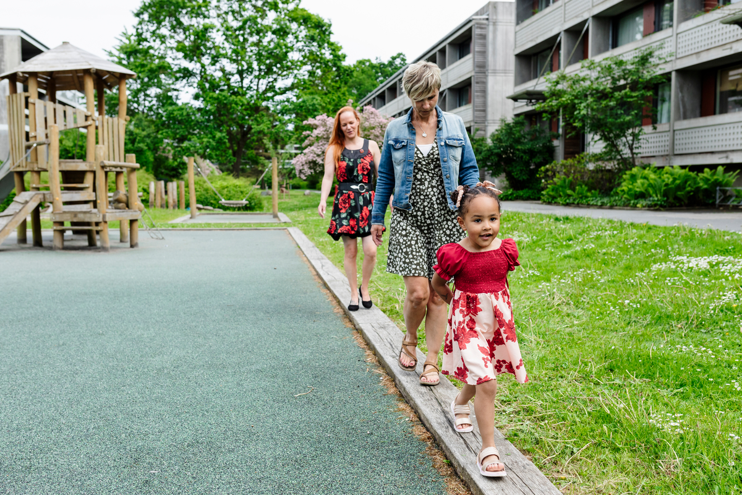
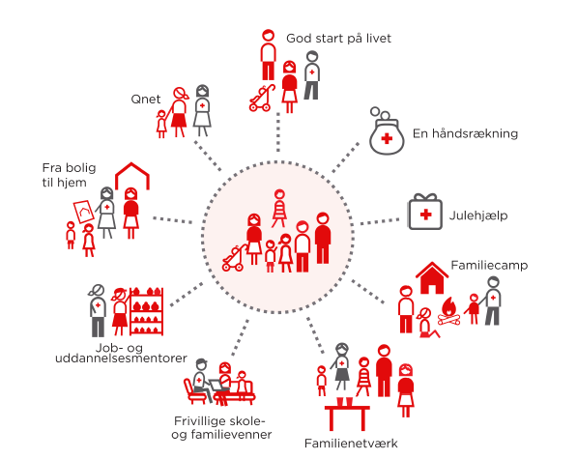
DRC INTERVENTIONS
40,000 Danes volunteer in Danish Red Cross national activities with 201 local branches.
Our activities foster support, companionship and increase network relations of those who might be vulnerable or left out of society in some way – elderly, newly arrived citizens, families in vulnerable positions, marginalized adults and youth, etc.
The common denominator: We combat loneliness and foster social relations! Two concrete examples are…
Social prescribing – a volunteer version!
As in the UK, we see a great interest in the social prescribing model – or, as we call it in Denmark, “community guidance”.
Family interventions: The families we are in touch with in DRC are some of the loneliest in Denmark (1 out of 2 individuals).
1:1 support, including family and school friends
Job and education mentors
Community activities such as family networks and family camps.
Financial support that enables children to be part of communities and experiences just like their friends.
4,745 vulnerable parents and children received volunteer support in 2023
Notes:
Now I will briefly give a few examples of our interventions.
As in the UK, social prescribing – usually the idea that the health sector; nurses, general practitioners, etc, should also be able to know the signs of when a patient could be in need of social relations, and not a medical intervention. We know of patients in Denmark who call their doctor every morning just to have somebody to talk to. In the social prescribing model, a doctor, a nurse, etc. will know the signs, and ask the patient if they wish to get in contact with a link worker – or a community guide as we call it in Danish – whose sole job is to help this citizen into a community or a 1-1 relation that suits them. In DRC, we are testing out a model where volunteers will be the community guides and be present at the local communal medical center. It’s a bit of a different model from the one we know in the UK.
Other examples of interventions in DRC are our family interventions. (Describe the model on the right) – we have 1:1 support, including family and school friends; etc.
A large study that we conducted showed that more than half of the people asked in this survey said that they were severely lonely (T-ILS).

Slide 13
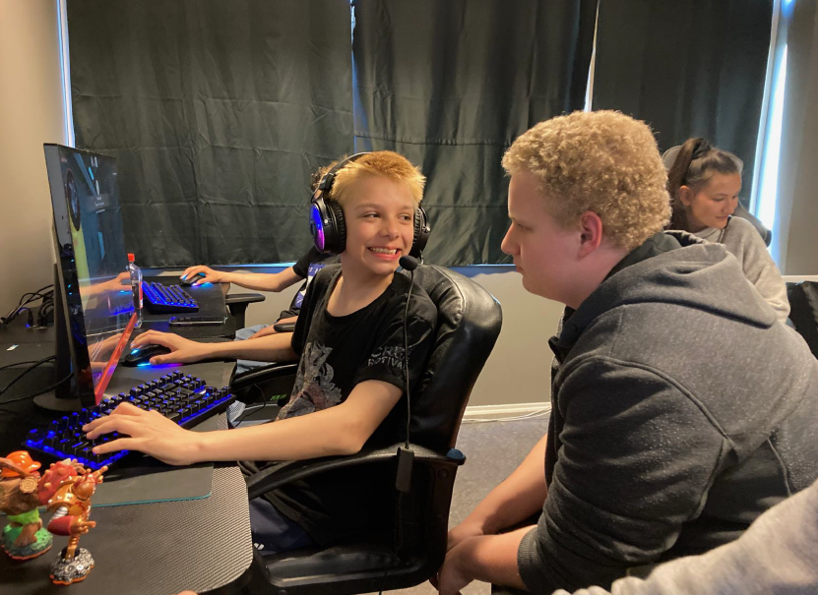
KFUM’s Sociale Arbejde: Go Gaming
Target group: Young adults in a socially vulnerable position with gaming as an interest
92% of young people play computer games at least once a week. Go Gaming taps into young people's interest - not the other way around.
Research* conducted of GO GAMING
Positive impact on well-being and social relations and on academic skills
Transferability of social skills from the digital to the physical world
Fosters well-being and creates social relations in a target group that can be difficult to reach.
*Betina Skov Jacobsen og Iben Nørup, Aalborg Universitets Institut for Sociologi og Socialt Arbejde, research conducted between 2021-2024.
”IT IS MORE COZY TO GAME HERE THAN AT HOME. HERE, I HAVE SOMEBODY TO TALK TO IN REAL LIFE – AND NOT ONLY ON THE SCREEN. MY FAVOURITE ACTIVITY IS WHEN WE DINE TOGETHER AND TALK ABOUT ALL SORTS OF THINGS”.
Notes:
Before I end this presentation,

Slide 14

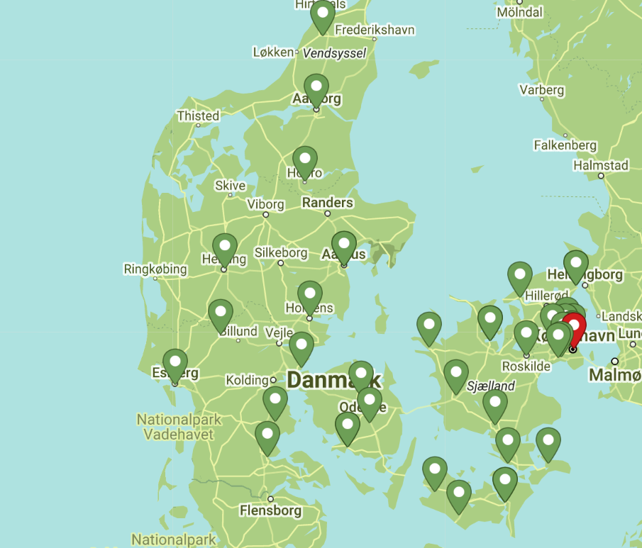
“headspace is a counseling service based on you and what you need to talk about. We are not psychologists (…). Most counselors are volunteers of all ages who are passionate about helping and listen without judgment.
All counselors receive training in counseling techniques and relevant legislation, and we link you up with guidance to professional help or other activities if needed.”

Slide 15
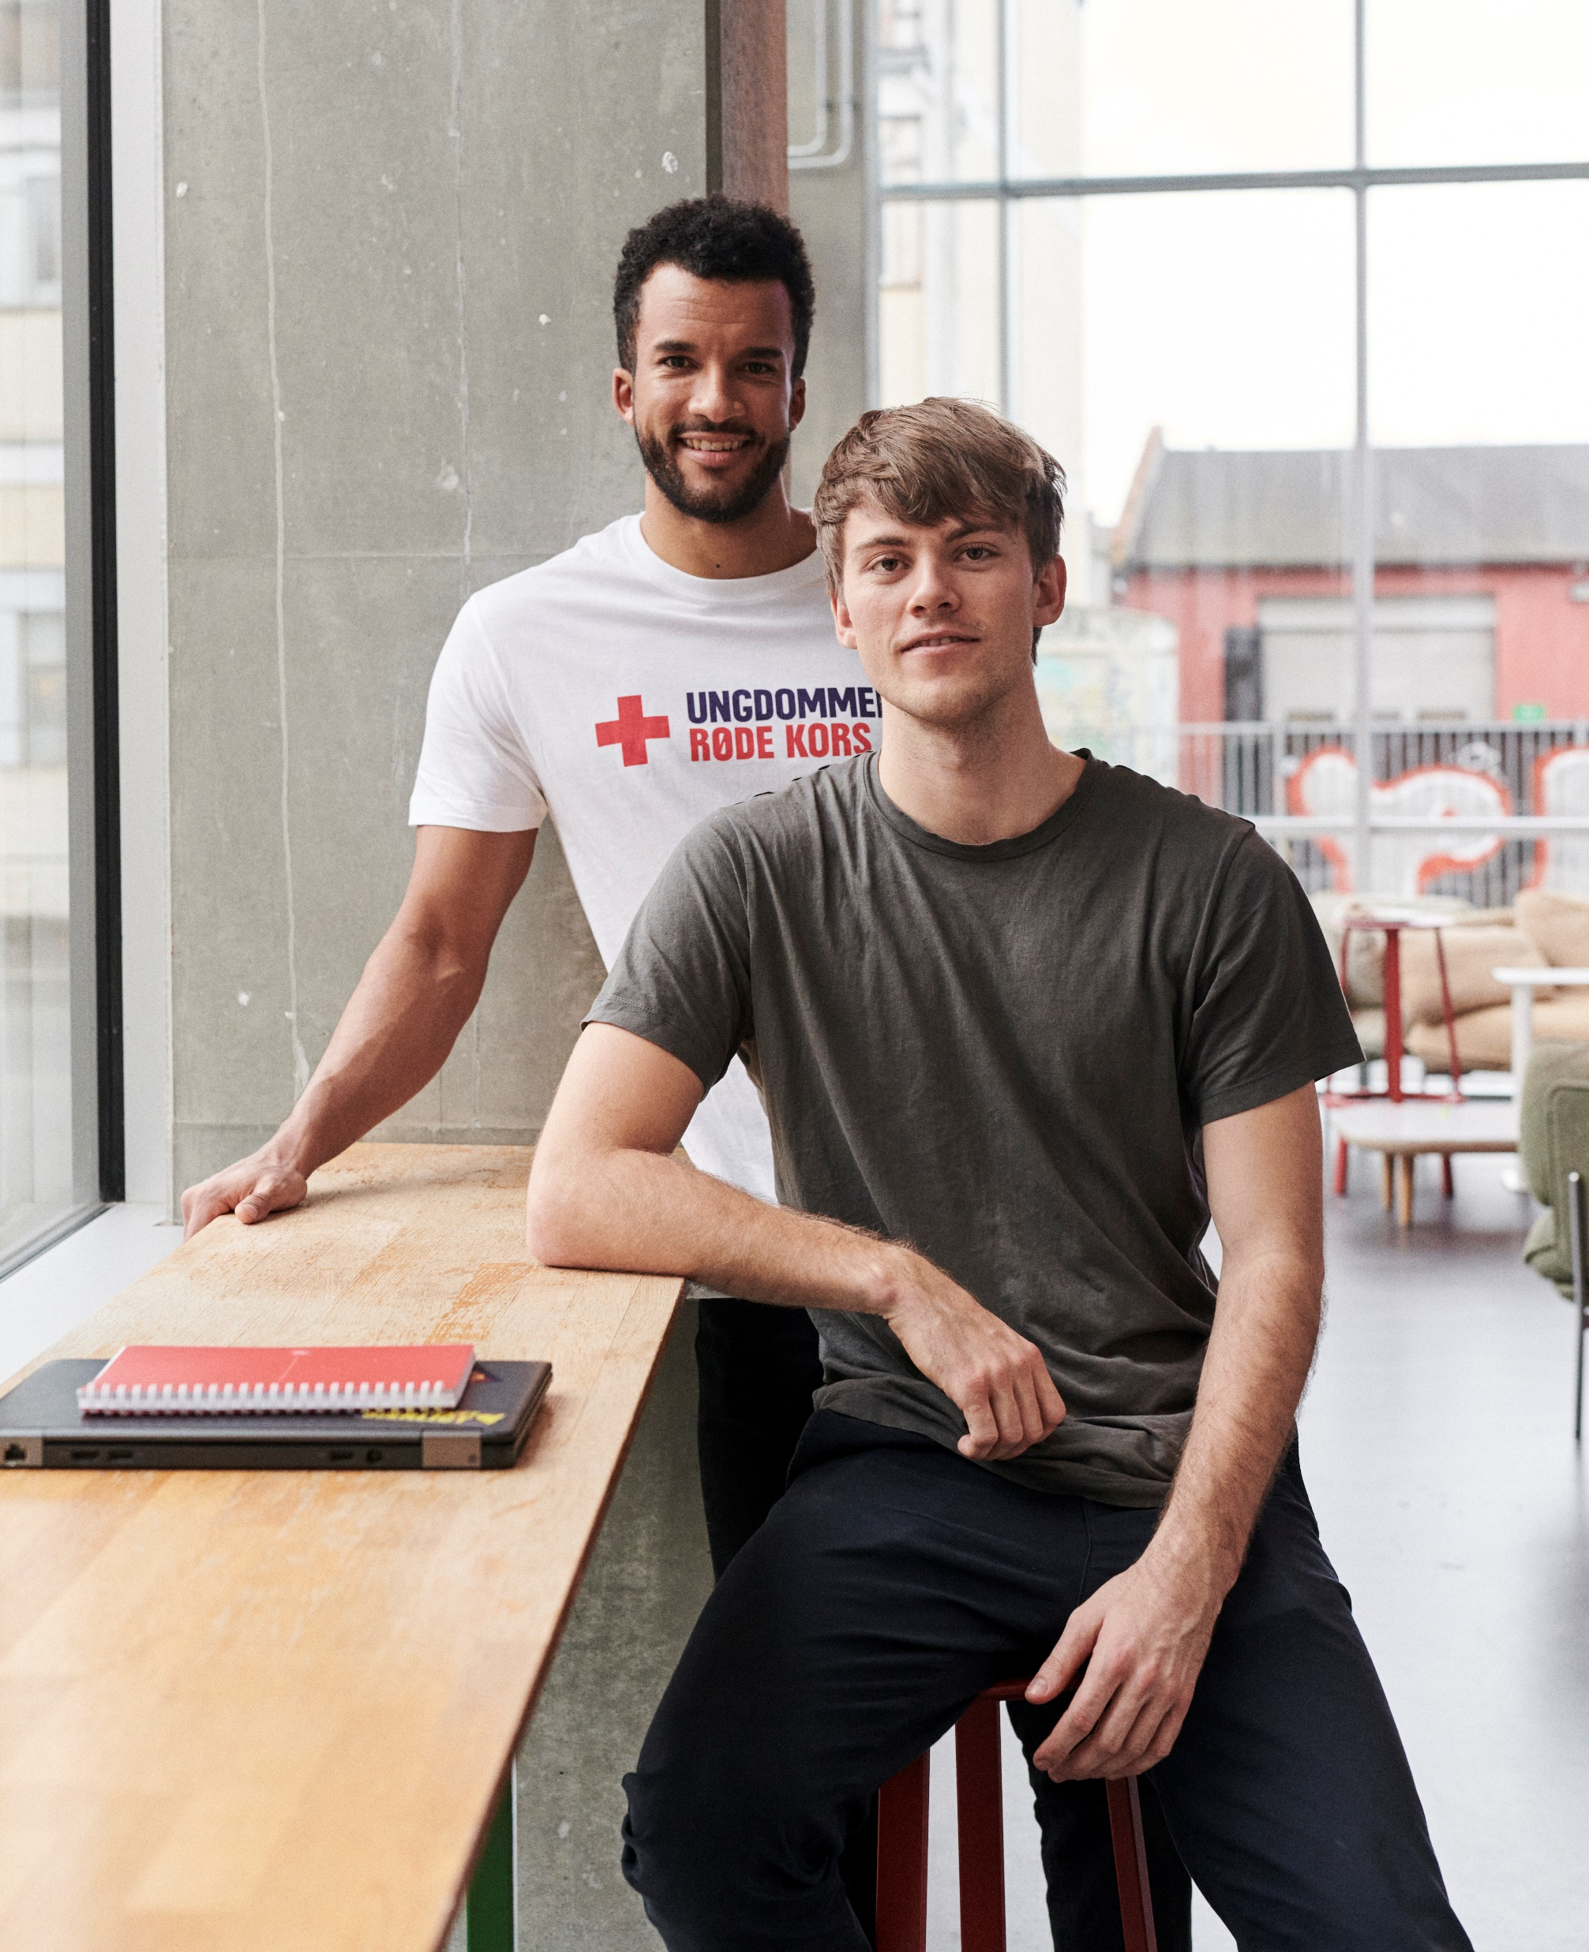

DANISH RED CROSS YOUTH…
…is a youth-led, voluntary, social organisation centred around youth-to-youth activities.
Initiatives in Denmark include mentoring, homework cafés, youth clubs, summer camps and a telephone hotline as well as social activities located at hospitals, prisons, orphanages, women’s shelters and asylum centers. Young volunteers facilitate workshops in Psychological First Aid and Life Skills.
10,000 children and young people in vulnerable positions participate in the social activities
4,000 young volunteers organise and run the local activities
300 on-going activities and 27 local branches all over Denmark

Slide 16
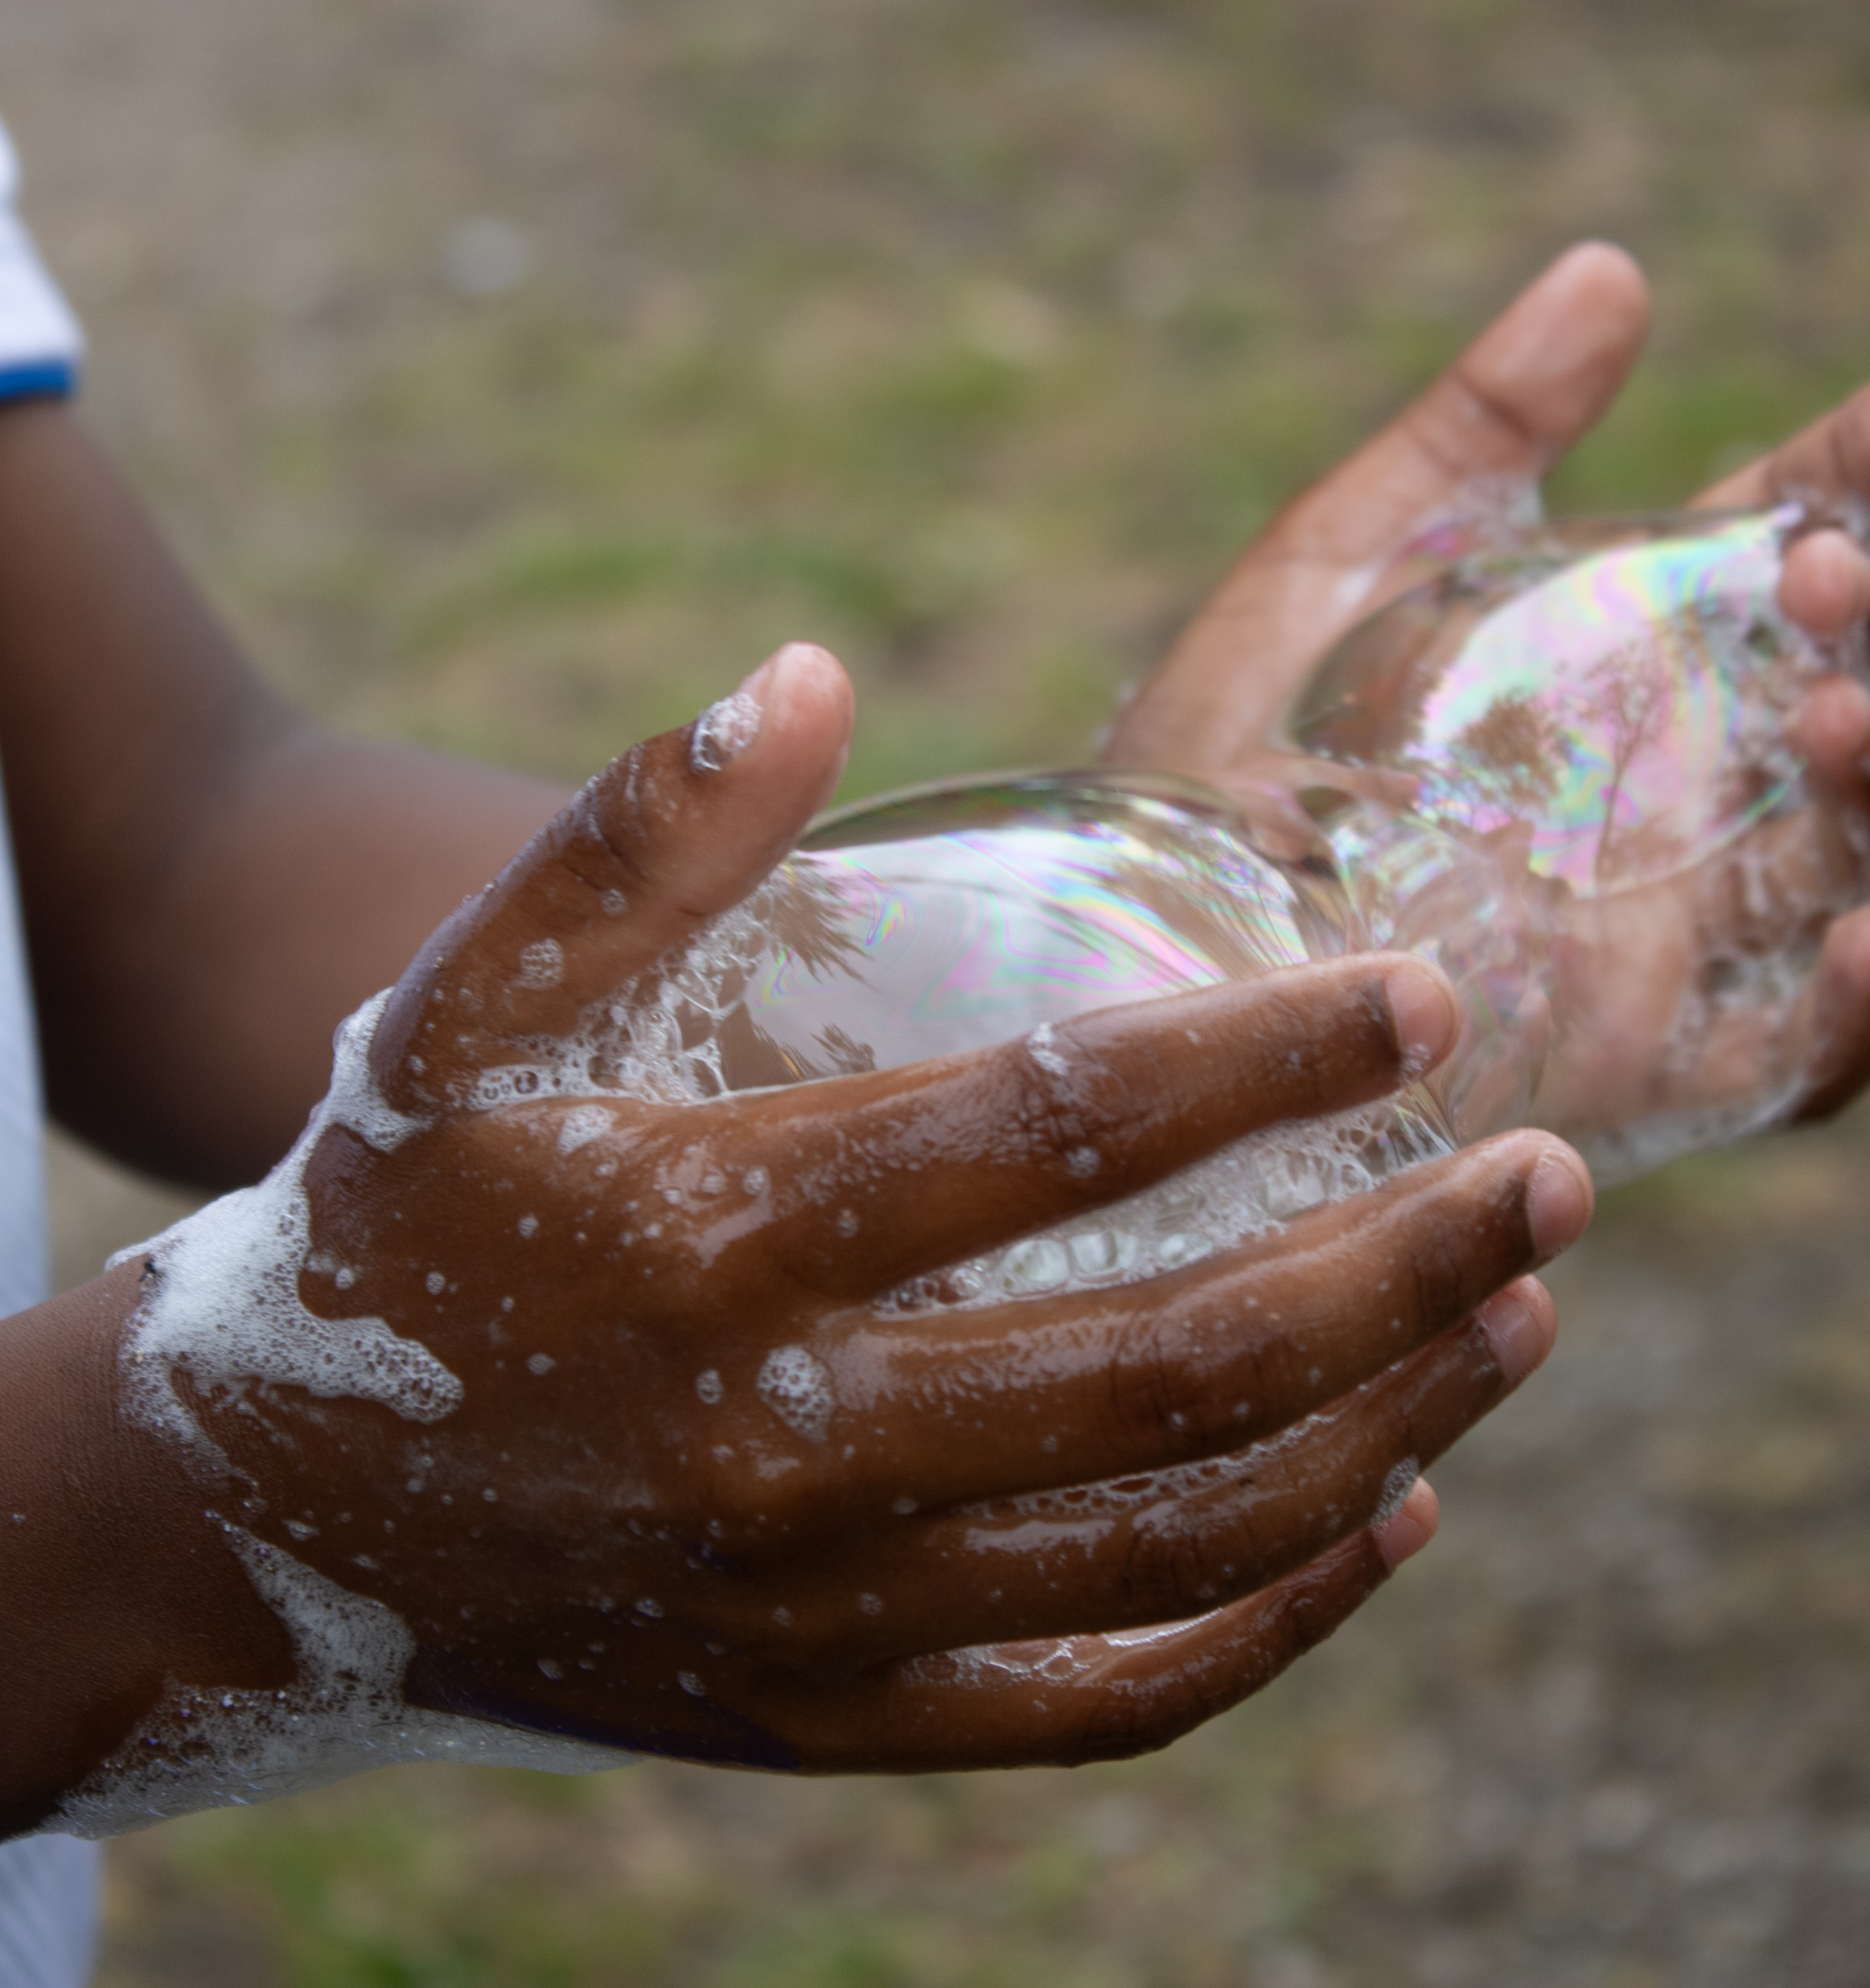
What can you and I do to combat loneliness?
Make sure to open our social circles; friend group; work relations, etc.
We all need to make sure that we are not too narrow in our understanding of what is normal.
Don’t be afraid to ask. When we say it out lout, we’re no longer on our own in feeling the way we do.
Make it clear: Loneliness is not your own fault!
Talk to children and young people about their use of social media, and be a role model yourself

Slide 17
Thanks for listening! Questions or comments?

Slide 18
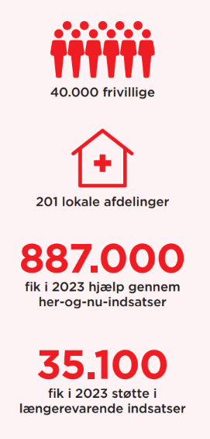
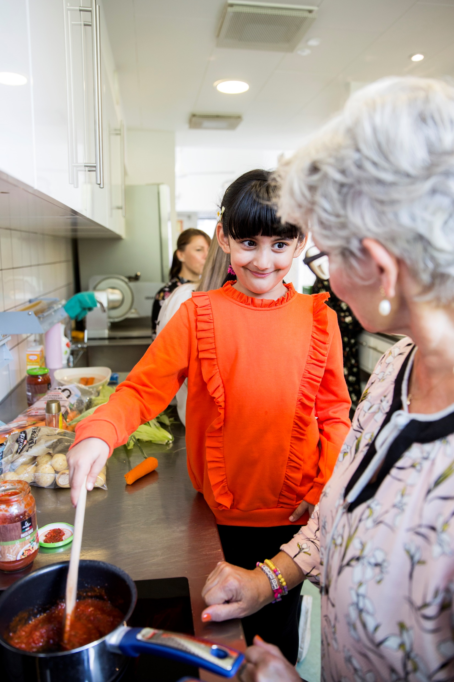
Danish Red Cross Interventions against loneliness
Notes:
Here you can see who we help the most with our activities nationwide. As you can see, the majority of the people we help are lonely and unhappy. But the number is probably even higher - because I think many volunteers who help vulnerable families with children or refugees and migrants would also recognize that loneliness and lack of access to communities are some of the things that they struggle with.
3,650 were visited or in contact with a Red Cross visiting friend in 2023. We also have networking groups, social cafés, helplines, safety calls, and we run a digital platform, SnakSammen, where people can talk to each other online. In hospitals we are there for people with few or no relatives few or no relatives, and who can also can support the relatives. In 2023 volunteers made their way to hospitals more than 775,000 times, and volunteer guardians were present with presence in the last hours for 1,715 dying people.
12,045 received help and support in 2023 in Red Cross voluntary integration efforts. In 73 municipalities, we ran activities for and with refugees and immigrants, such as social cafés, employment support, volunteer friends and friendship families (Venner Viser Vej), homework help and a nationwide online platform - sprogland.dk- where you can practice Danish together with volunteers from the Red Red Cross volunteers. Volunteers also act as temporary guardians for unaccompanied refugee children.

