Slide 1


Maritime digital infrastructure
and connectivity
Strategic Market
entry platform
Sweden 2026

Slide 2

Strategic
background

Slide 3






Total defence reinforcement
The most substantial reinforcement of the total defence since the Cold War is now taking place in Sweden. The country is undergoing a strategic transformation in defence and resilience driven by:
evolving geopolitical challenges
NATO integration
commitment to national preparedness
The Swedish approach is rooted in the Total Defence concept, widely regarded as one of the most comprehensive, future-oriented and adaptable defence models in Europe. This strategy is based on a whole-of-society approach, integrating military, civil and private-sector capabilities to protect national security.
DUAL-USE LEGAL FRAMEWORK
The import and export of dual-use items is regulated by Regulation (EU) 2021/821 setting up a Union regime for the control of exports, brokering, technical assistance, transit and transfer of dual-use items.
The regulation is legally binding in all member states. In Sweden, the regulation is supplemented with the Dual-Use Items and Technical Assistance Control Act (SFS 2000:1064).
Sweden’s Military Equipment Act (1992:1300) and regulation (1992:1303) specify permit requirements and other obligations for activities related to military equipment.
BUDGET
Sweden is rapidly rearming in an international context and making major investments in both the civil and the military defence. The military defence is being allocated over SEK 180bn and the civil defence more than SEK 37.5bn from the national budget by 2030.
Currently set at 2.8% for 2026, Sweden’s military defence expenditure will reach 3,5% of the GDP, while the expenditures for civil defence will amount to 1,5% by 2030 in an effort to proactively prepare for NATO’s expected increase in member state’s defence budgets.
In order to reach that level, Sweden will borrow SEK 300bn. This loan-financed defence investment will run from this year until 2030, after which the raised framework will be incorporated into the current defence budget until 2035.
The Government proposes allocating SEK 3 bn. to civil defence in 2026, SEK 4.2 bn. in 2027 and SEK 4.6 bn. in 2028. These proposals total approximately SEK 12 bn. in 2026–2028.
3,5%
of the GDP for military defence and
1,5%
for civil defence upgrades allocated by 2030

Slide 4





Why sweden?
Sweden is home to one of Europe's most sophisticated and well-established defence technology sectors, with a strong export focus and capacity.
The technological edge is built on three structural advantages
5th biggest defence market
13th biggest defence market
Strategic autonomy and high R&D investment
Sweden maintains a highly independent, European-oriented and self-sufficient defence industry, allowing it to develop and deploy advanced technologies without reliance on non-EU suppliers.
Over 15% of the combined annual turnover of the industry is reinvested into R&D.
1
NATO interoperability and European defence integration
Sweden’s NATO accession has strengthened its alignment with European and transatlantic defence frameworks, making it a strategic link between Nordic, European and other NATO defence industries.
Interoperability with NATO enhances Sweden’s role in European security, offering joint defence procurement opportunities for Danish companies.
2
The Triple Helix approach
The Swedish Government maintains strong cooperation with private defence enterprises and aims at creating and maintaining frameworks that ensure rapid technology commercialisation and dual-use innovation.
Swedish defence clusters include the major cities in Sweden - Stockholm, Linköping, Örebro and Gothenburg – which facilitate the triple helix cooperation, with a strong public, private and academia presence.
3

Slide 5




maritime digital infrastructure and connectivity – swedish context and vulnerabilities
Sweden’s maritime digital infrastructure domain is a critical, high-value dual-use target. Recent concentrated damage to Baltic subsea cables and growing GNSS/cyber interference incidents demonstrate that an adversary can rapidly degrade Sweden’s C2 systems, logistics and situational awareness without open kinetic warfare.
Context setting
Concentrated damage to Baltic subsea cables has risen sharply since 2023, creating real risk of partial or local connectivity loss that affects defence and civil systems. Recent reporting documents multiple cable incidents across the region.
Major Swedish ports are rapidly digitalising (e.g. Gothenburg’s Digital Port Call), increasing operational efficiency but also expanding the overall vulnerability to cyber-security breaches and attacks.
Swedish authorities are developing shore-based navigation support and Smart Port Call initiatives. The increased operational risks that are present in the Baltic, require a holistic approach to Maritime Domain Awareness.
GNSS jamming and spoofing in the Baltic is a known and demonstrable hazard. Monitoring and mitigation efforts exist but remain a capability shortfall for sustained operations.
Sweden has a national cyber/digital security strategy that supports integration of digital resilience into wider security policy – this creates a policy lever for tighter civil-military standards and a higher degree of information sharing.
Principal vulnerabilities
Connectivity single points: subsea cables and single-provider satellite/terrestrial links can be severed or congested, degrading C2, logistics and port ops
Expanded cyber/OT attack surface: port IT/OT integration (digital port calls, port cranes, berth systems creates entry vectors into critical logistics chains
Navigation integrity risks: GNSS jamming/spoofing can blind or mislead vessels and coastal sensors, which in turn poses serious security risks to the critical infrastructure
Civil-military seams: civilian systems often lack classification, segmentation or contingency interfaces for military use; legal and operational arrangements for rapid transition are immature.
Detection and attribution delay: distinguishing accident from sabotage (and proving attribution) is slow, limiting timely deterrent/response options
Notes:
Swedish Armed Forces develops new C-UAS Capability - Swedish Armed Forces
Sweden tests new anti-drone systems
Drönarförmågan inom flygvapnet fortsätter att utvecklas - Försvarsmakten

Slide 6
Introduction to the
Scope your business model+

Slide 7
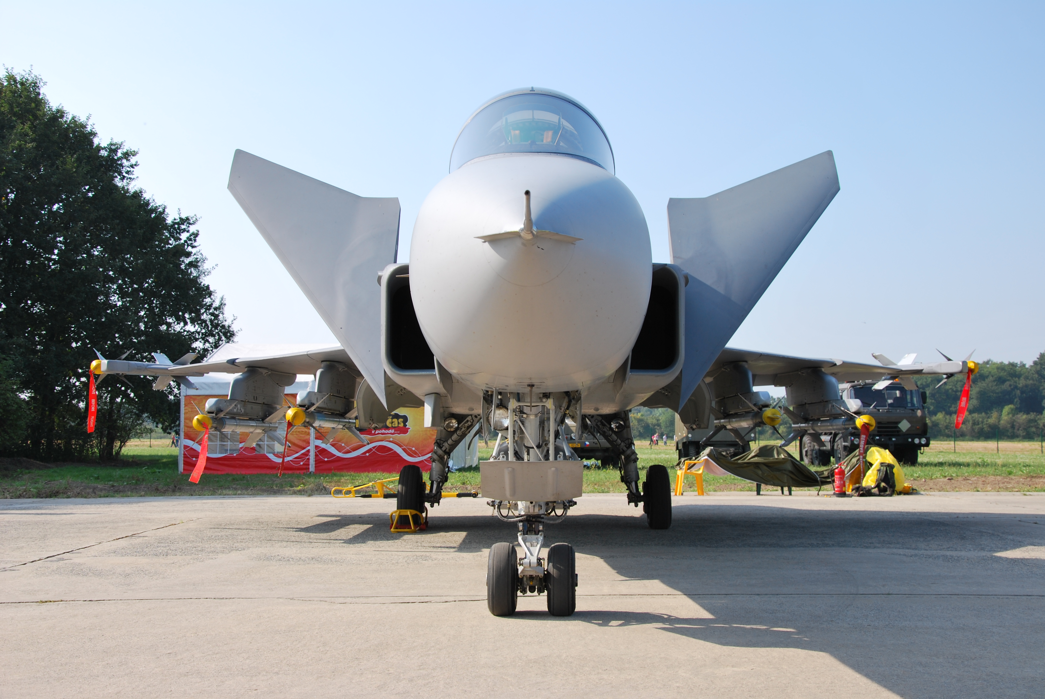




Use Sweden’s Strong Market Position
Does your company deliver solutions within the digital maritime infrastructure and connectivity space? Then this program is for you.
maritime digital infrastructure
And connectivity Companies wishing to explore FIRST internationalisation opportunities
Join a select group of Danish SMEs in a 2-month SBM+ program designed to help you navigate the Swedish defence sector and explore maritime digital infrastructure market opportunities. Through expert guidance and tailored advice you will deepen your understanding of the market, validate your concept with our expert advisory board and build a strong foundation for market-entry, or market-maturing engagement.
Your company gets
Unique understanding of one of Denmark's most important neighbouring markets
A tailored go-to-market strategy for your company in Sweden
Understanding of Swedish Defence Materiel Administration’s procurement process
Qualified market validation, feedback and direct solution sparring from key sector stakeholders in Sweden
Opportunity to participate in pilot projects
Valid network and knowledge of Sweden from day one.
Access opportunities
In sweden
With solid experience from the Swedish market, we offer strategic guidance and access to a seasoned advisory board from the industry. This support is designed to help you refine your market approach and strengthen your business case for Sweden.
two-step approach
Our two-step approach begins with tailored strategic advice provides a gateway to new partnerships through participation in a market visit.
Further Engagement
On the basis of this program, you can become a part of the Embassy’s increasing activities in the dual-use space. From roundtables to Embassy Dialogues, you can meet the network the SBM+ will help you initiate, and get an even larger opportunity for first pilot-projects and clients in the market.

Slide 8


Program Timeline
Workshop i: Targeted Market Knowledge
At this Workshop, we will tailor your business model via the Business Model Canvas methodology and help tailor your offering and pitch to the specific conditions of the Swedish market .This includes reviewing your current offering and identifying where strategic adjustments are needed to align with local expectations and regulations, including standards and more.
In addition, you will gain a comprehensive overview of the defense-sector in Sweden, including its regulatory environment, key stakeholders, current infrastructure challenges and opportunities driven by new targets.
We will explore the subtle cultural and market-specific differences that distinguish the Danish landscape from the Swedish one.
3
march
2026
Workshop II: MARKET VISIT
23-24
march 2026
Sparring session with a specialised Advisory Board, where you get further insight into your go-to-market strategy and address your solution-related questions in dialogue with key Swedish stakeholders.
Insights into how to navigate Sweden's public procurement landscape, become a supplier and build strategic partnerships within defence and security, provided by the Danish Embassy in Sweden and program partners.
REporting
Based on feedback from the Advisory Board, the Embassy will produce a go-to-market plan for your company, and detail the best strategy to enter the Swedish market.
Next
step
Opportunity to showcase your solution at Kongsberg’s Critical Maritime Infrastructure (CMI) Protection Test Bed and explore pilot opportunities with key market stakeholders

Slide 9



Four solution domains of interest
1
2
Undersea resilience and cable protection
surfACE AND coastal monitoring network
Protect and continuously monitor subsea critical infrastructure – data cables, energy interconnectors, pipelines and seabed sensors.
Ideal offerings and capabilities
Autonomous underwater vehicles (AUVs)
Autonomous underwater surveilance nodes
Seabed communications network
Rapid intervention ROVs/USVs
Digital twin of seabed infrastructure
Achieve continuous situational awareness of Swedish territorial and adjacent Baltic waters through autonomous surface and aerial assets, integrated with radar and intelligence systems.
Ideal offerings and capabilities
Autonomous surface vessels (ASVs/USVs)
Coastal surveillance drones (UAVs)
and counter-drone systems (C-UAV)
Distributed sensor buoys
Secure coastal communication
3
4
Cyber and data infrastructure security
Command, control and decision support
Ensure all digital maritime data (AIS, sensor, navigation, port logistics) remains trusted, verifiable and resilient under hybrid or cyber disruption.
Ideal offerings and capabilities
Hardened data exchange and cross-domain gateways
AI-driven anomaly detection in network traffic
Digital twin of maritime infrastructure
Enable real-time decision-making and cross-agency coordination across military, intelligence and civilian actors.
Ideal offerings and capabilities
Maritime Digital Operations Centre (MDOC)
Autonomous Mission Management System (AMMS)
Secure Data Cloud for MDA
Simulation and wargaming platform

Slide 10
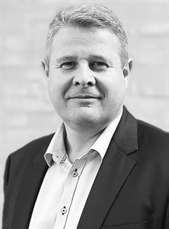



For more details and registration, contact:
Program
Fee*
DKK 36,900 – full price in 2026 (non-SMEs) for full programme.
DKK 9,225 – 75% reduced price in 2026 for SMEs, ensured by the Ministry of Foreign Affairs, for full programme. Max 7 companies.
Travel expenses not included.
Michael Nørregaard
International Business Adviser
micnor@um.dk
Helle Lyngberg Carlsen
International Business Adviser
hellyn@um.dk
Monica Paraipan
Commercial Adviser - Defence
Embassy of Denmark in Sweden
anpara@um.dk
+46 73 672 75 24
Amanda Cecilie
Haar-Jørgensen
Commercial Adviser - Maritime
Embassy of Denmark in Sweden
ajorge@um.dk
+46 84 06 75 24

