Slide 1

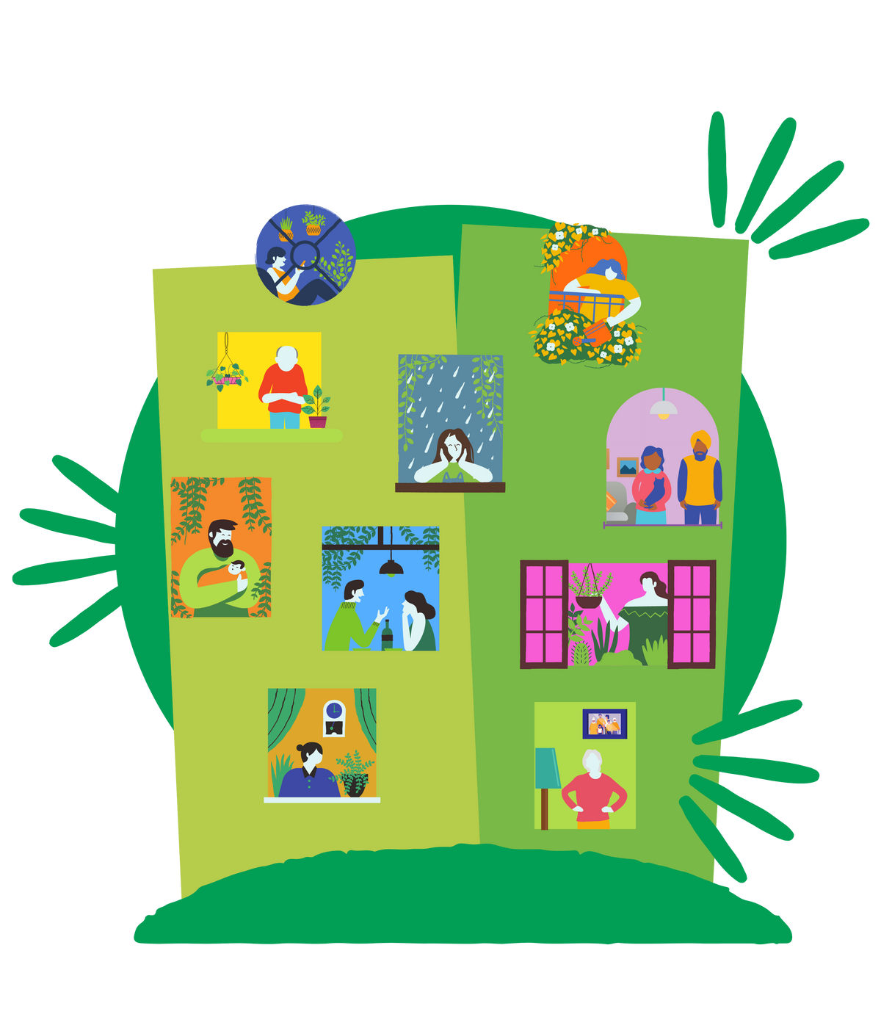
The role that society plays in reducing youth loneliness
Helayna Jenkins IEng
Principal Loneliness Champion – London Borough of Bromley
bromley.gov.uk/loneliness

Slide 2

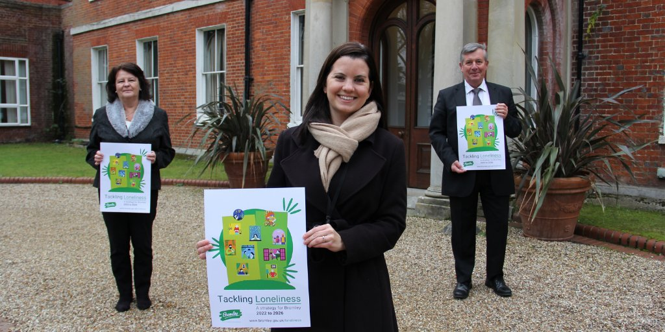
Tackling loneliness
in Bromley
Launching the strategy
bromley.gov.uk/loneliness
Notes:
Overview of the Three priorities from the Tackling Loneliness Strategy – www.bromley.gov.uk/loneliness
Priority 1 -
Tackling loneliness workshop
Simply Connect Bromley
Connecting with Social Prescribers
Priority 2 -
Bromley’s guide to accessible transport – www.bromley.gov.uk/loneliness
Venues for hire catalogue – Community Links Bromley
Priority 3 –
Work outside of Bromley with government (DCMS), other Local Authorities and Organisation to help share best practice and raise awareness to challenge stigma of loneliness
Campaigns in Bromley using social media, low cost initiatives and bringing the community together.

Slide 3
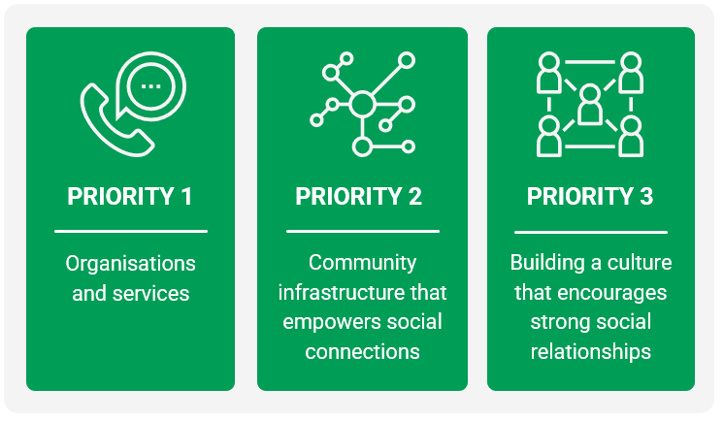
Tackling loneliness
in Bromley
Priorities to tackling loneliness in Bromley
bromley.gov.uk/loneliness
Notes:
Overview of the Three priorities from the Tackling Loneliness Strategy – www.bromley.gov.uk/loneliness
Priority 1 -
Tackling loneliness workshop
Simply Connect Bromley
Connecting with Social Prescribers
Priority 2 -
Bromley’s guide to accessible transport – www.bromley.gov.uk/loneliness
Venues for hire catalogue – Community Links Bromley
Priority 3 –
Work outside of Bromley with government (DCMS), other Local Authorities and Organisation to help share best practice and raise awareness to challenge stigma of loneliness
Campaigns in Bromley using social media, low cost initiatives and bringing the community together.

Slide 4

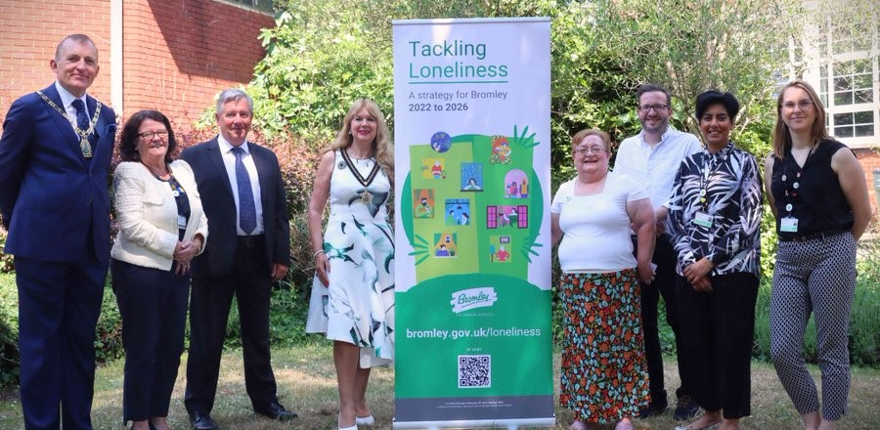
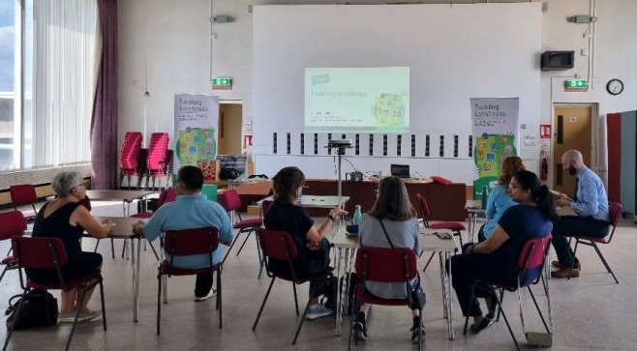

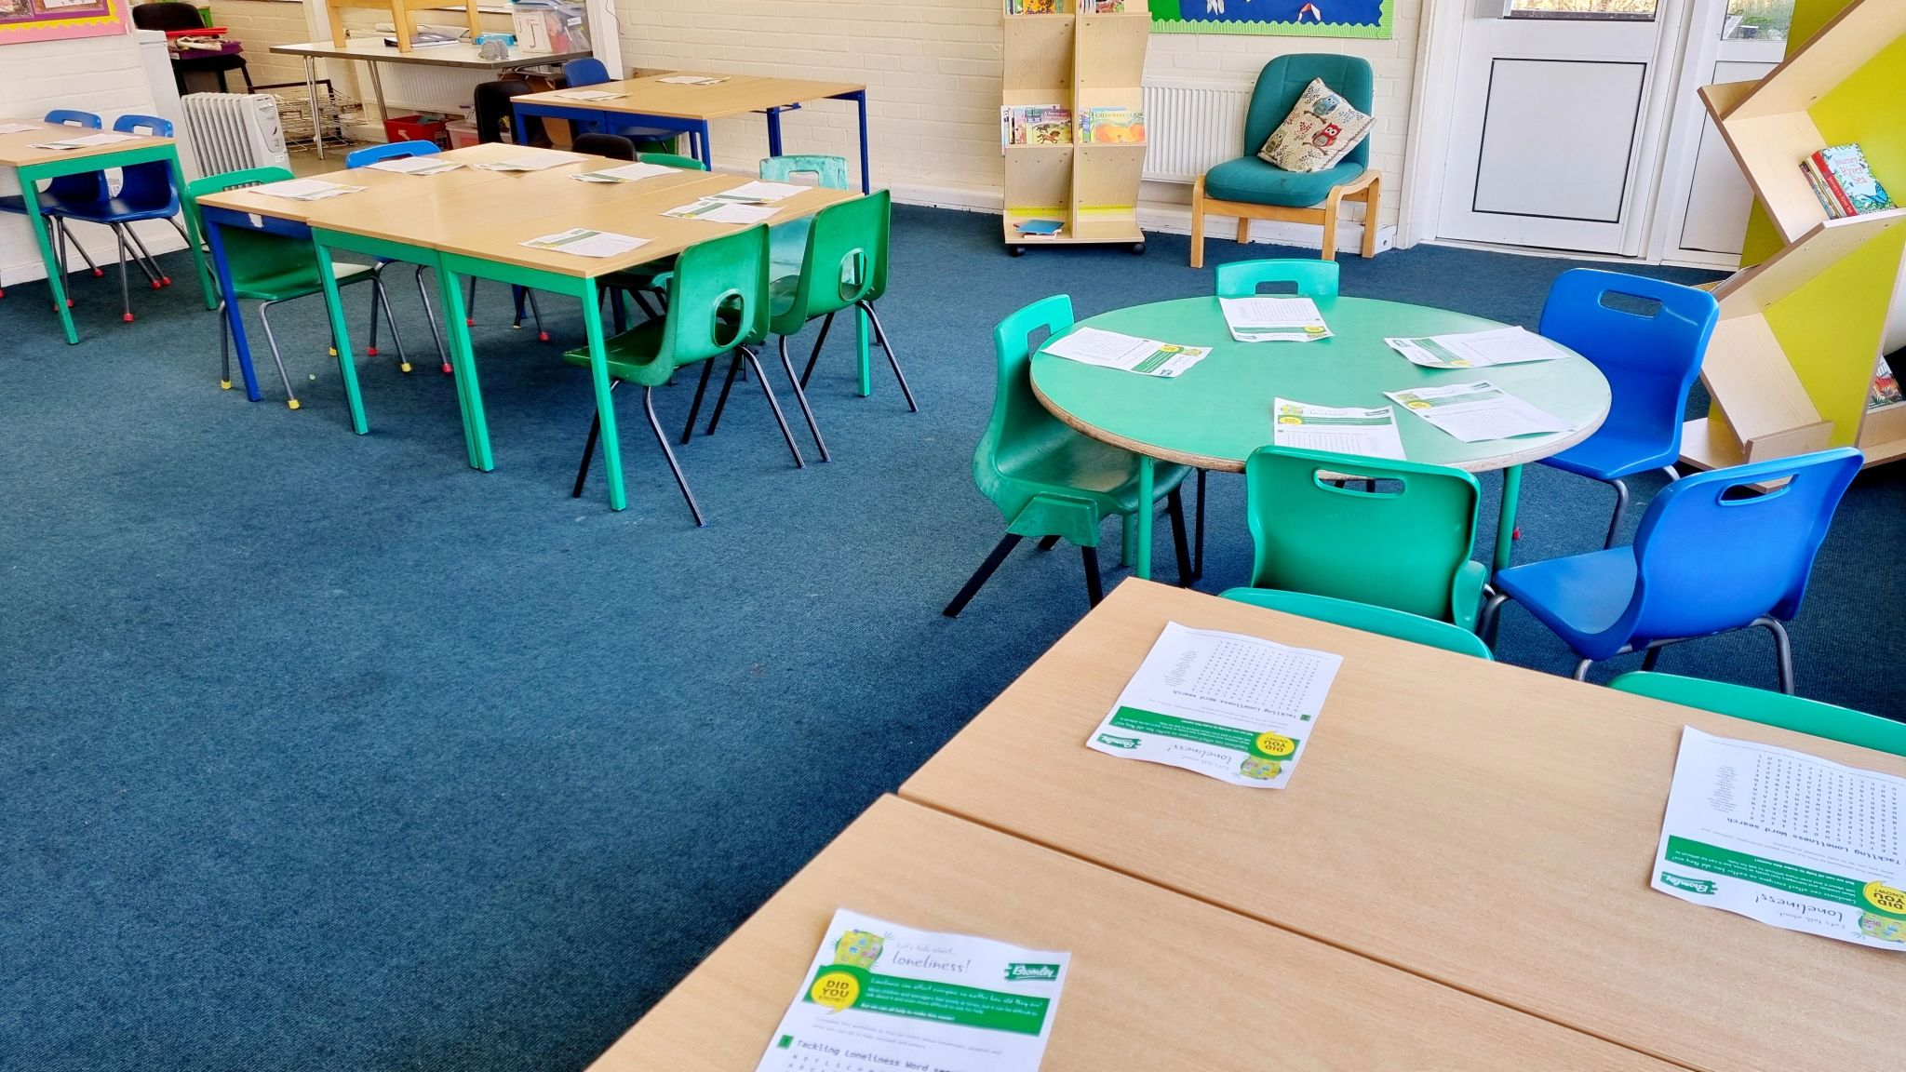
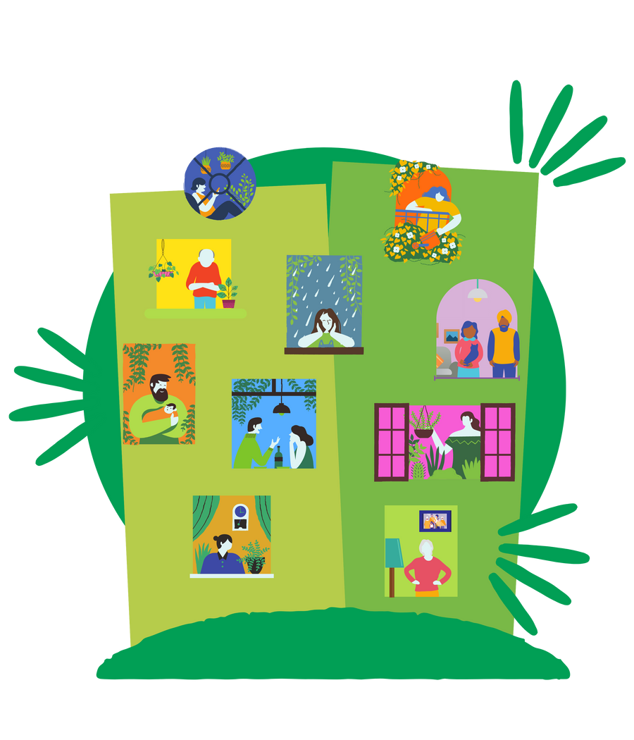

London Borough of Bromley, UK
Tackling Loneliness Strategy 2022 to 2026
PRIORITY 1
In June 2023, the London Borough of Bromley hosted a Tackling Loneliness Summit where over 100 professionals, residents and voluntary sector individuals attended to hear of practical support, initiatives and meet those promoting initiated to support young people and adults in Bromley. The full event was recorded and can be viewed here.
Organisations and services
In March 2023, Bromley Council piloted a FREE, 1.5 hour Tackling Loneliness Workshop to inform professionals about loneliness. To date, over 530 people have attended the workshop including professionals and Bromley Youth Council, Councillors, youth MET Police team, school nurses, Bromley Y – local youth mental health service practitioners, Social workers and many more.
A ‘workshop lite’ version of this training has been turned into an interactive workbook session for schools. Over 1,800 young people have completed a workbook to date.
After listening to partners feedback around finding community groups and activities, one central, online platform. Simply Connect Bromley currently has over 1,500 activities from 650 organisations listed on the platform and is continually growing. You will find The Great Friendship Project, youth choirs, reading groups, crafting activities and ‘Friday Night’ groups for young people are promoted on here.
www.bromley.gov.uk/loneliness

Slide 5

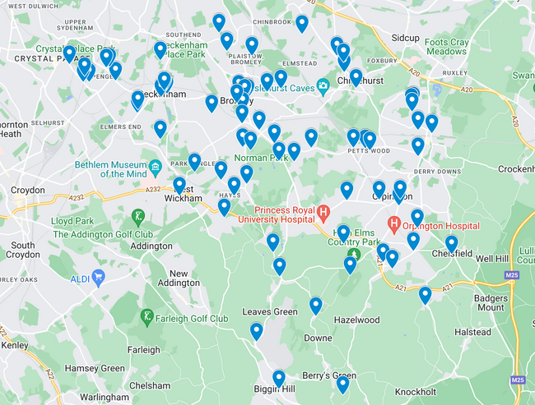




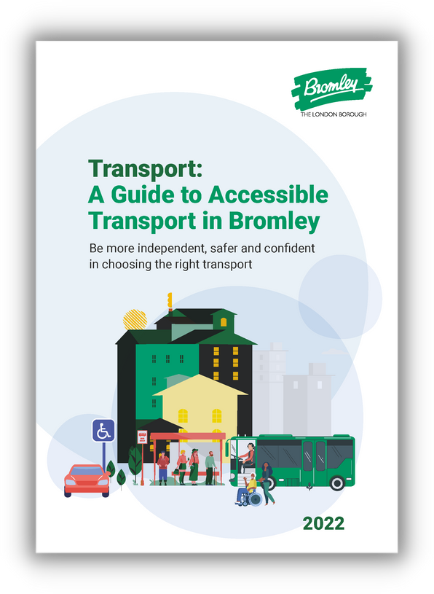
London Borough of Bromley, UK
Tackling Loneliness Strategy 2022 to 2026
PRIORITY 2
Community infrastructure that empowers social connections
Bromley is taking a proactive approach by working collaboratively with partners, the voluntary sector and internal departments to help bridge the digital divide, to help reduce loneliness and isolation .
Across the borough, we were informed by people of financial backgrounds that they wanted to find free, inexpensive and accessible venues to host activities for young people and adults. Our voluntary and community sector partner provide this information for all to view.
Residents in Bromley living with a disability of all ages told us that they wanted to know how best to easily travel across the borough to continue connecting with others. We replied by creating an accessible transport guide to support all residents travel needs within Bromley. This FREE guide can be accessed here.
www.bromley.gov.uk/loneliness

Slide 6
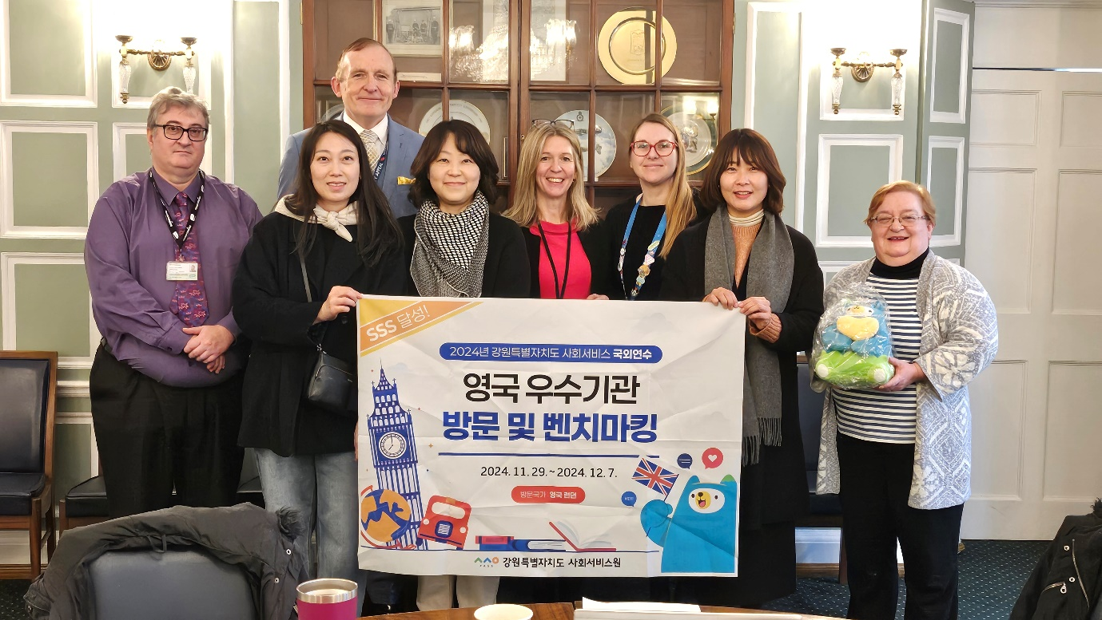




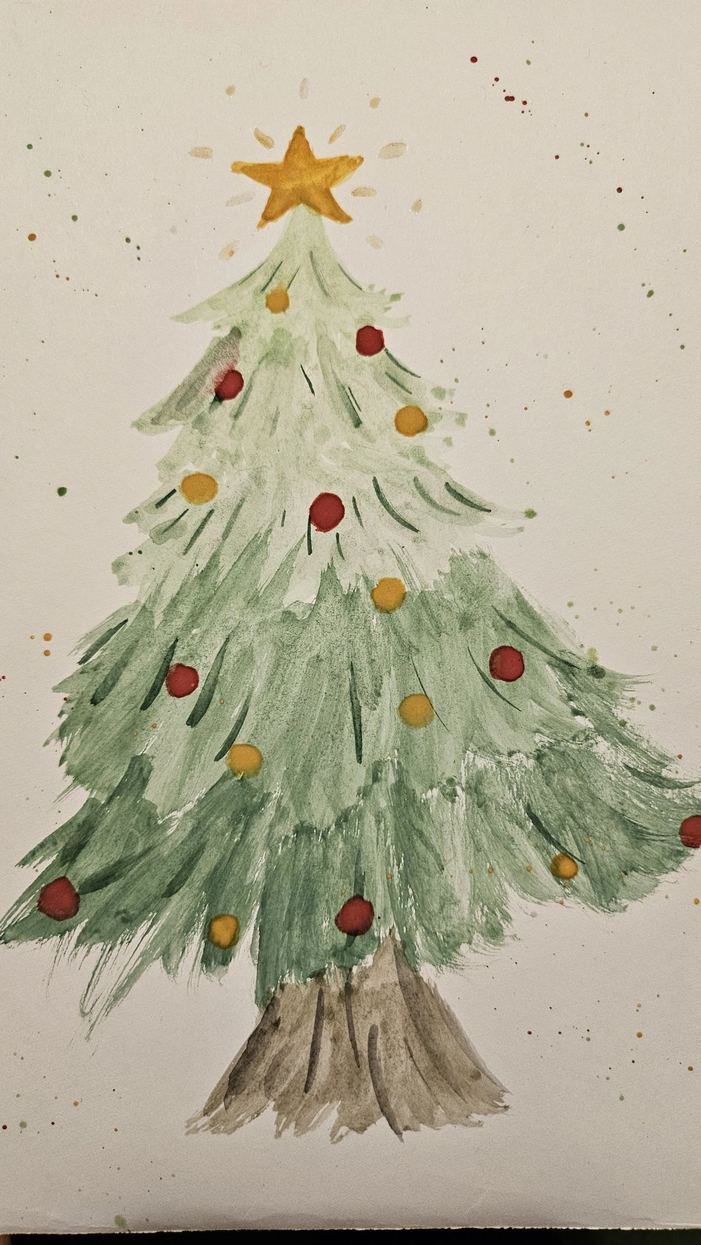



London Borough of Bromley, UK
Tackling Loneliness Strategy 2022 to 2026
The Principal Loneliness Champion is now an on the Advisory Board for the Tackling Loneliness Hub and Campaign to End Loneliness.
Bromley is now the Local Governments Association’s (LGA’S) expert council in Loneliness with a special interest group running in 2024 to support other local authorities
PRIORITY 3
Building a culture that encourages strong social relationships
In December 2024, the London Borough of Bromley hosted a delegation of South Korean Social Workers from Gangwon. The delegation was interested in how the local authority is helping to support residents of all ages using low cost, or no cost preventative measures to tackle loneliness and isolation.
In 2024, 25 schools and our family centers and after-school clubs created over 5,700 Christmas cards, supporting people who may be older, homeless, those in hospital, have health concerns, and carers of all ages across Bromley. Since the first Christmas card project in 2022, over 11,000 cards have been made!
Bromley continues to raise awareness and reduce the stigma of loneliness during Loneliness Awareness Week, Befriending Week, Children’s Mental Health Week, hosting council run Big Lunches, and community outreach within community venues. Engagement with schools, unpaid carers, new parents and those with disabilities continue to be a priority.
www.bromley.gov.uk/loneliness

Slide 7
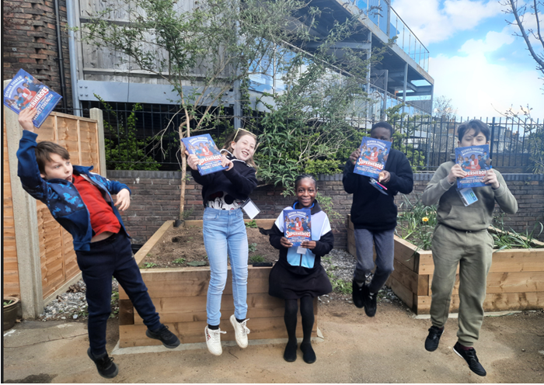
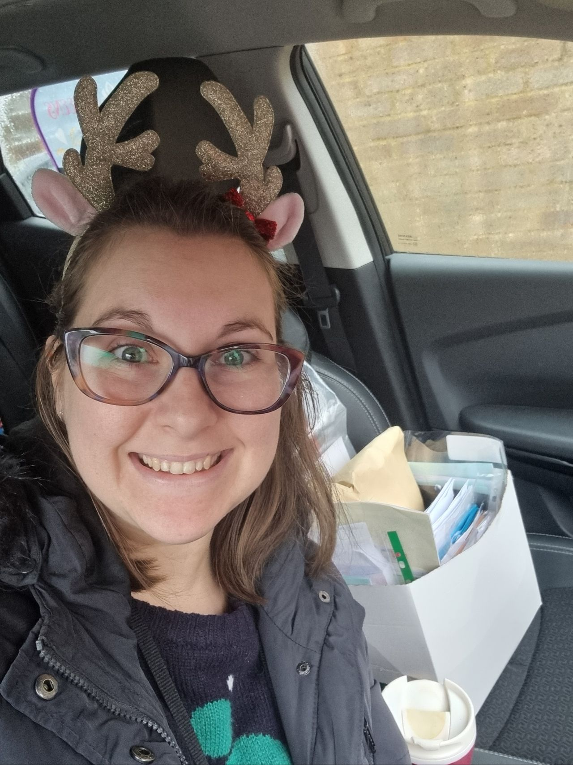
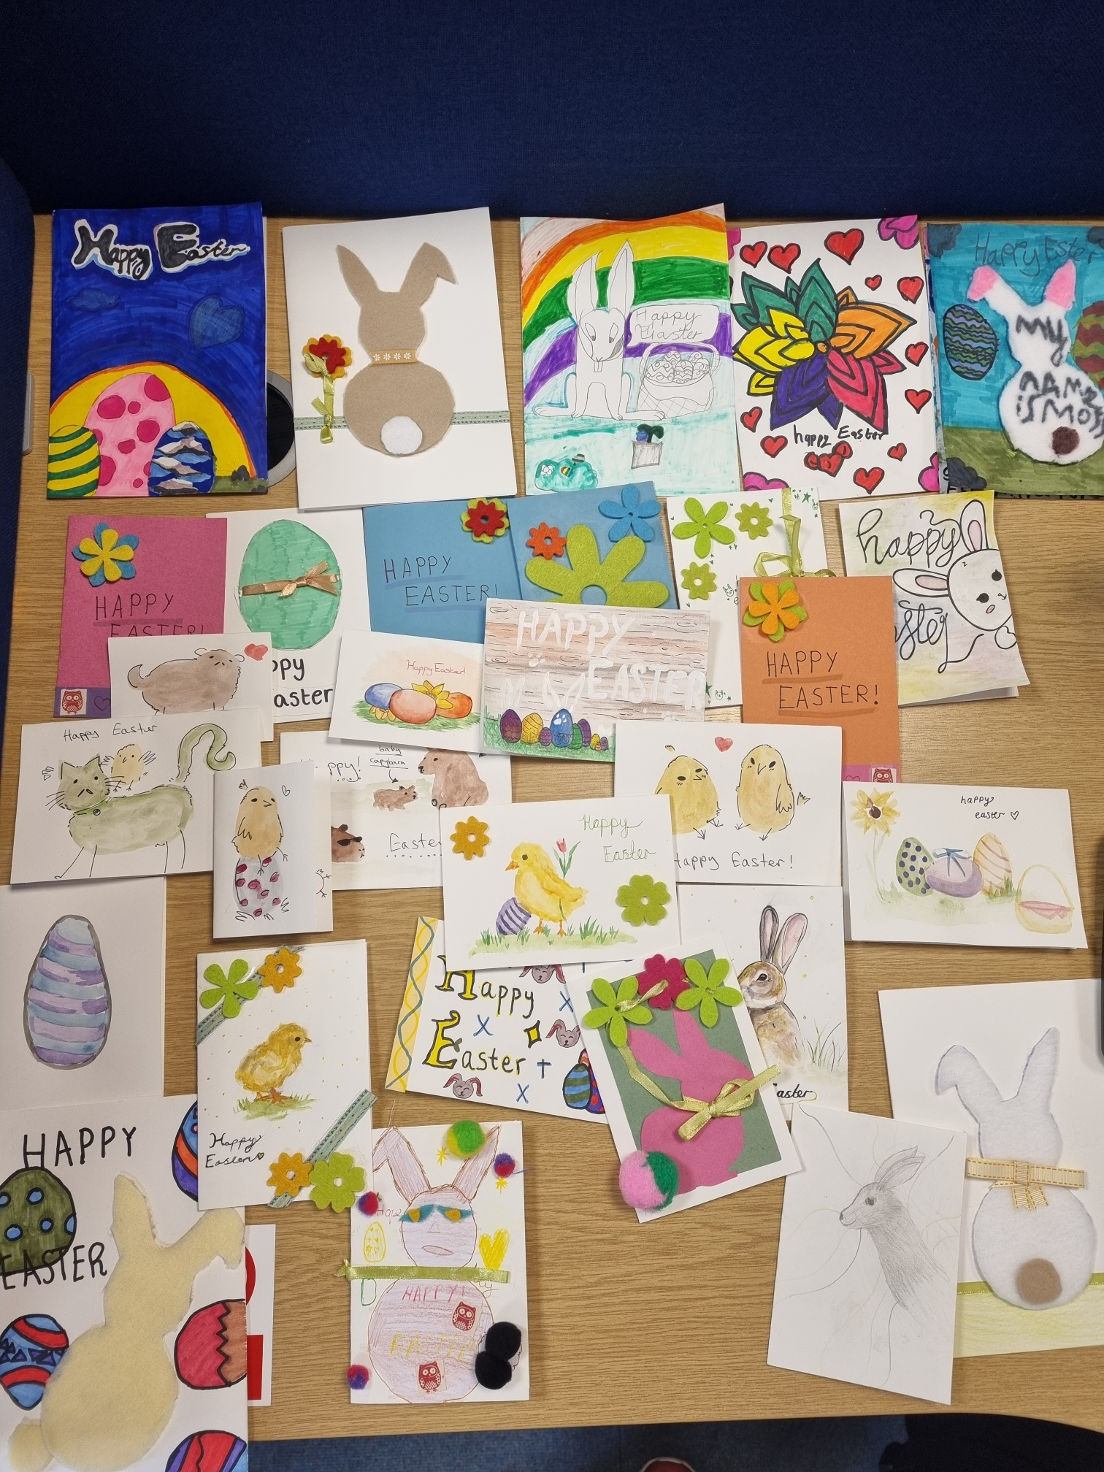
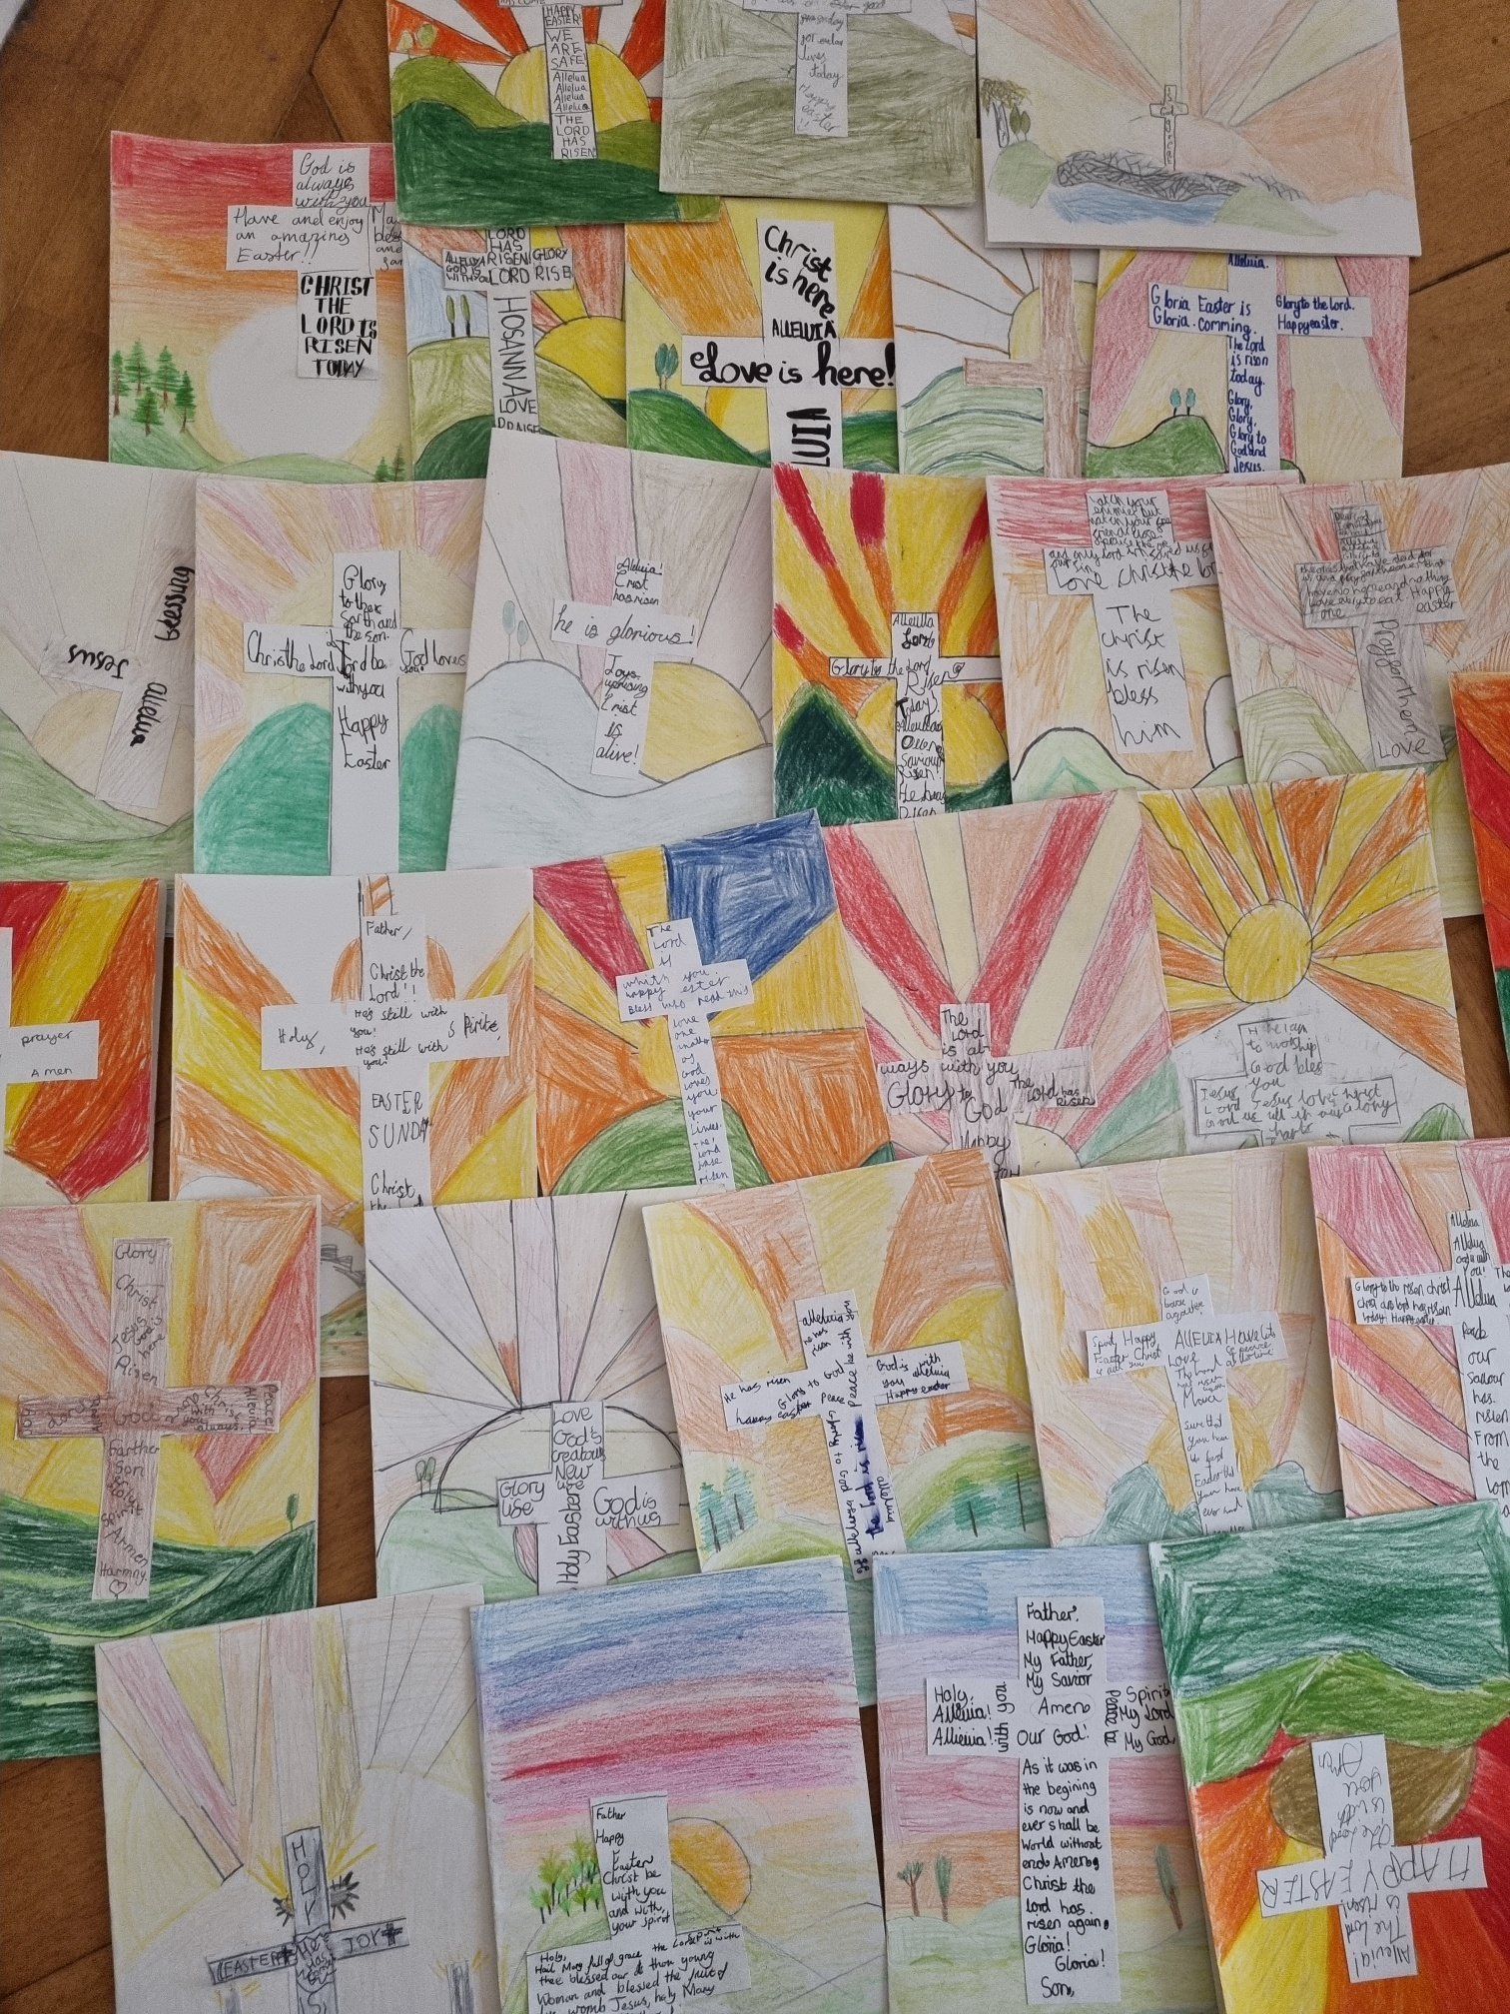
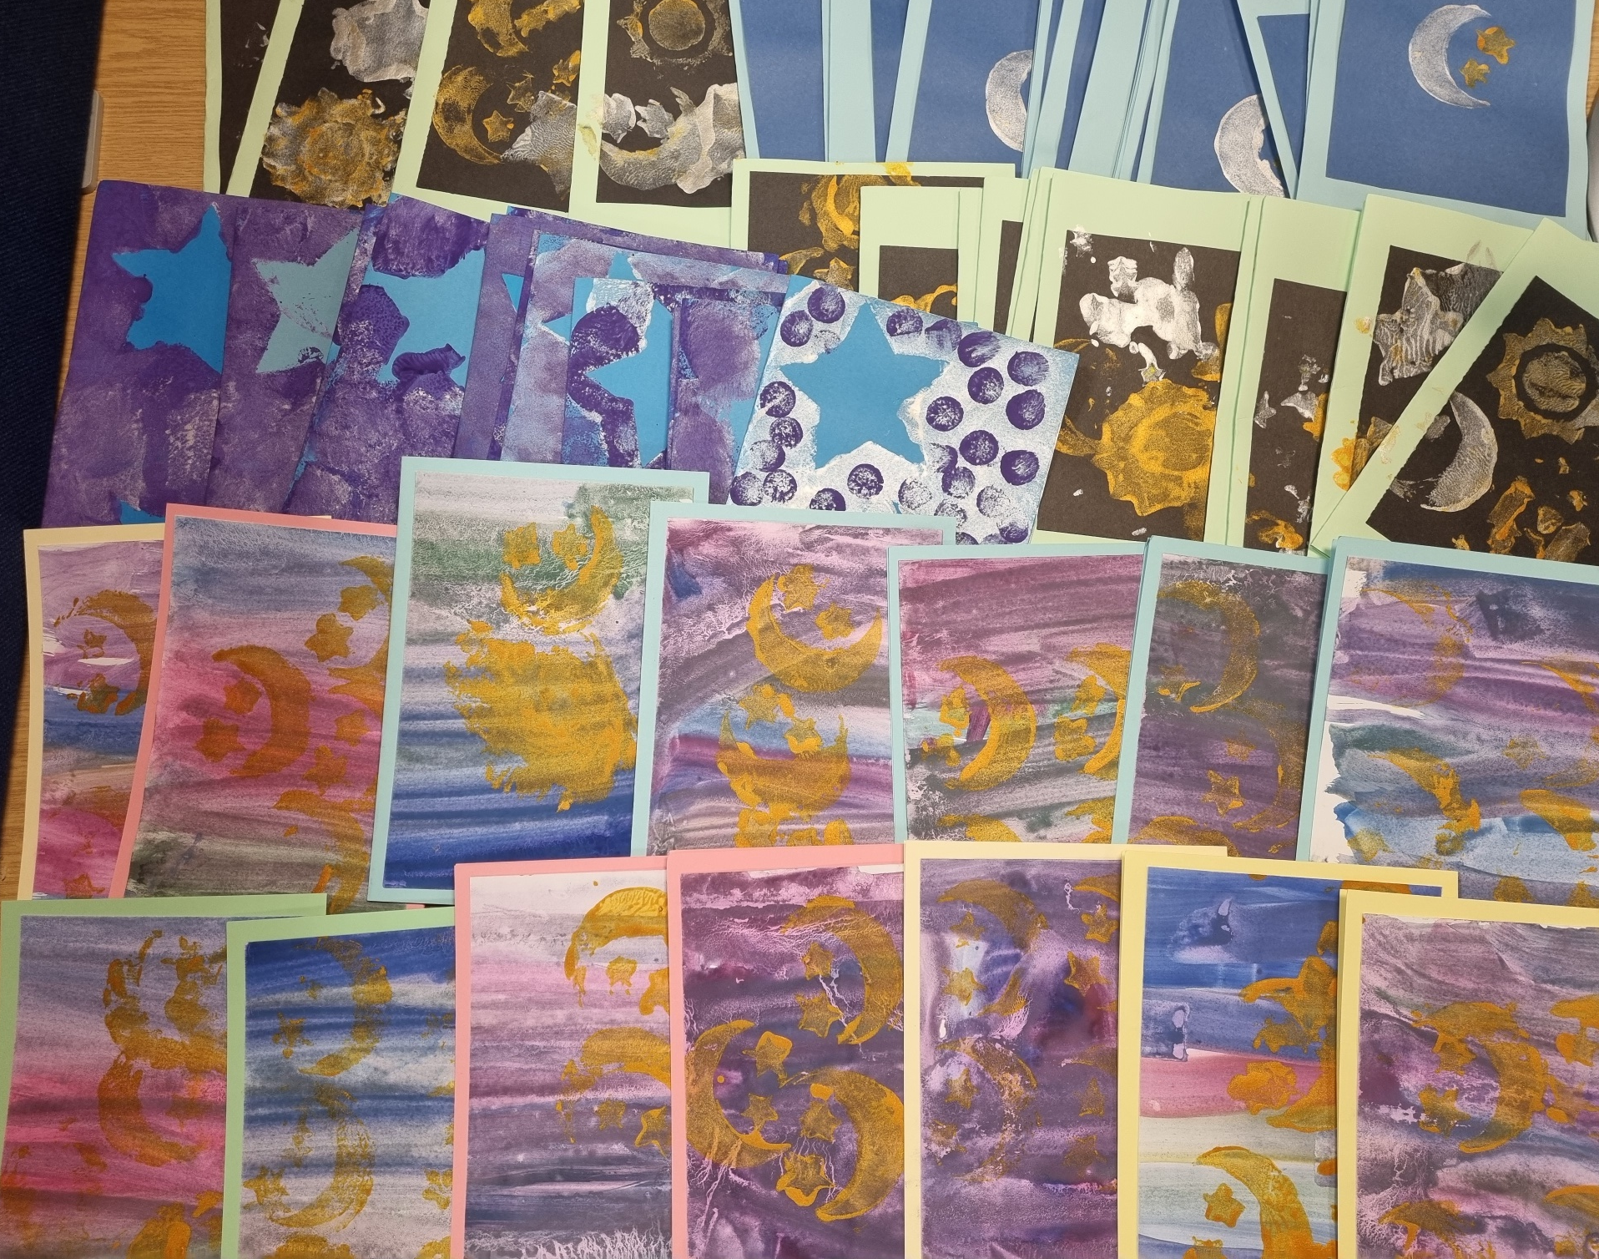
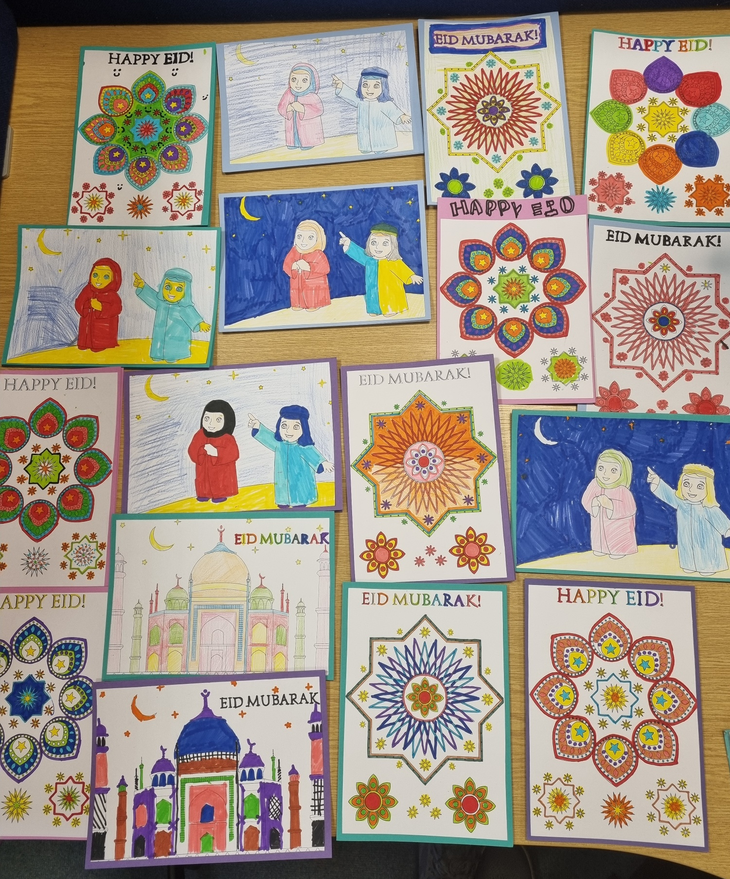
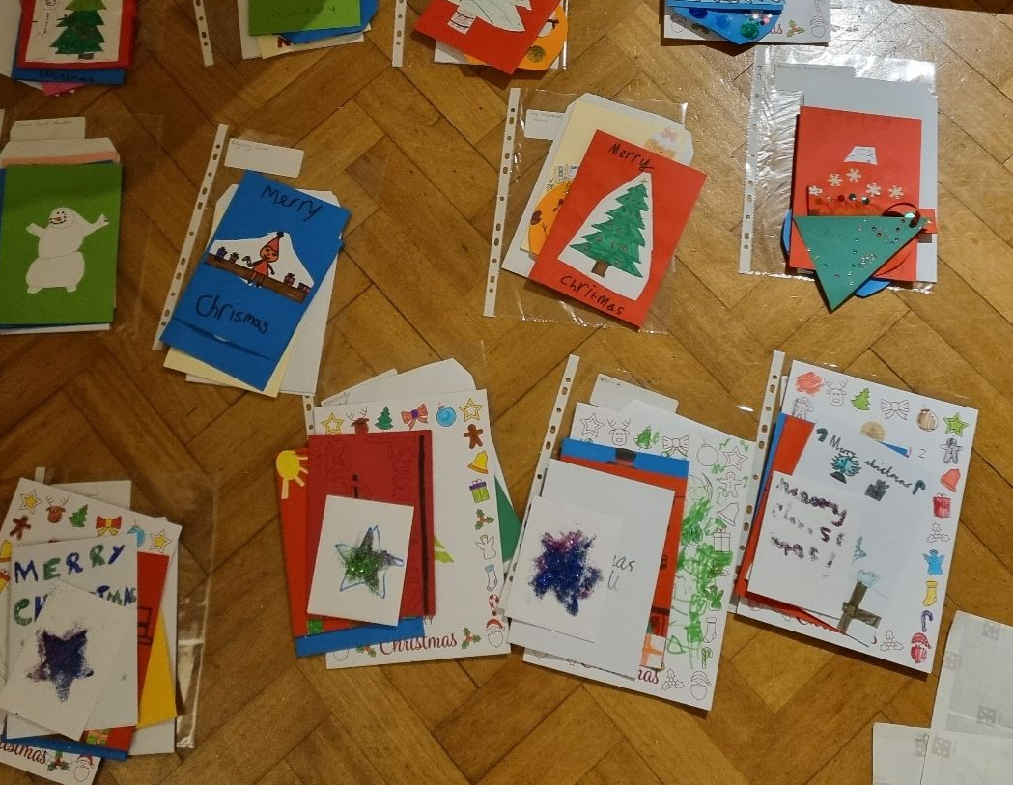
London Borough of Bromley, UK
Tackling Loneliness Strategy 2022 to 2026
Connecting people to the community and Youth Loneliness
www.bromley.gov.uk/loneliness

Slide 8
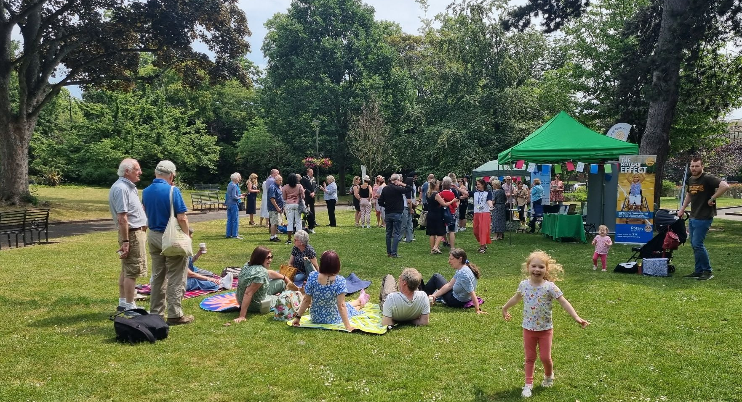
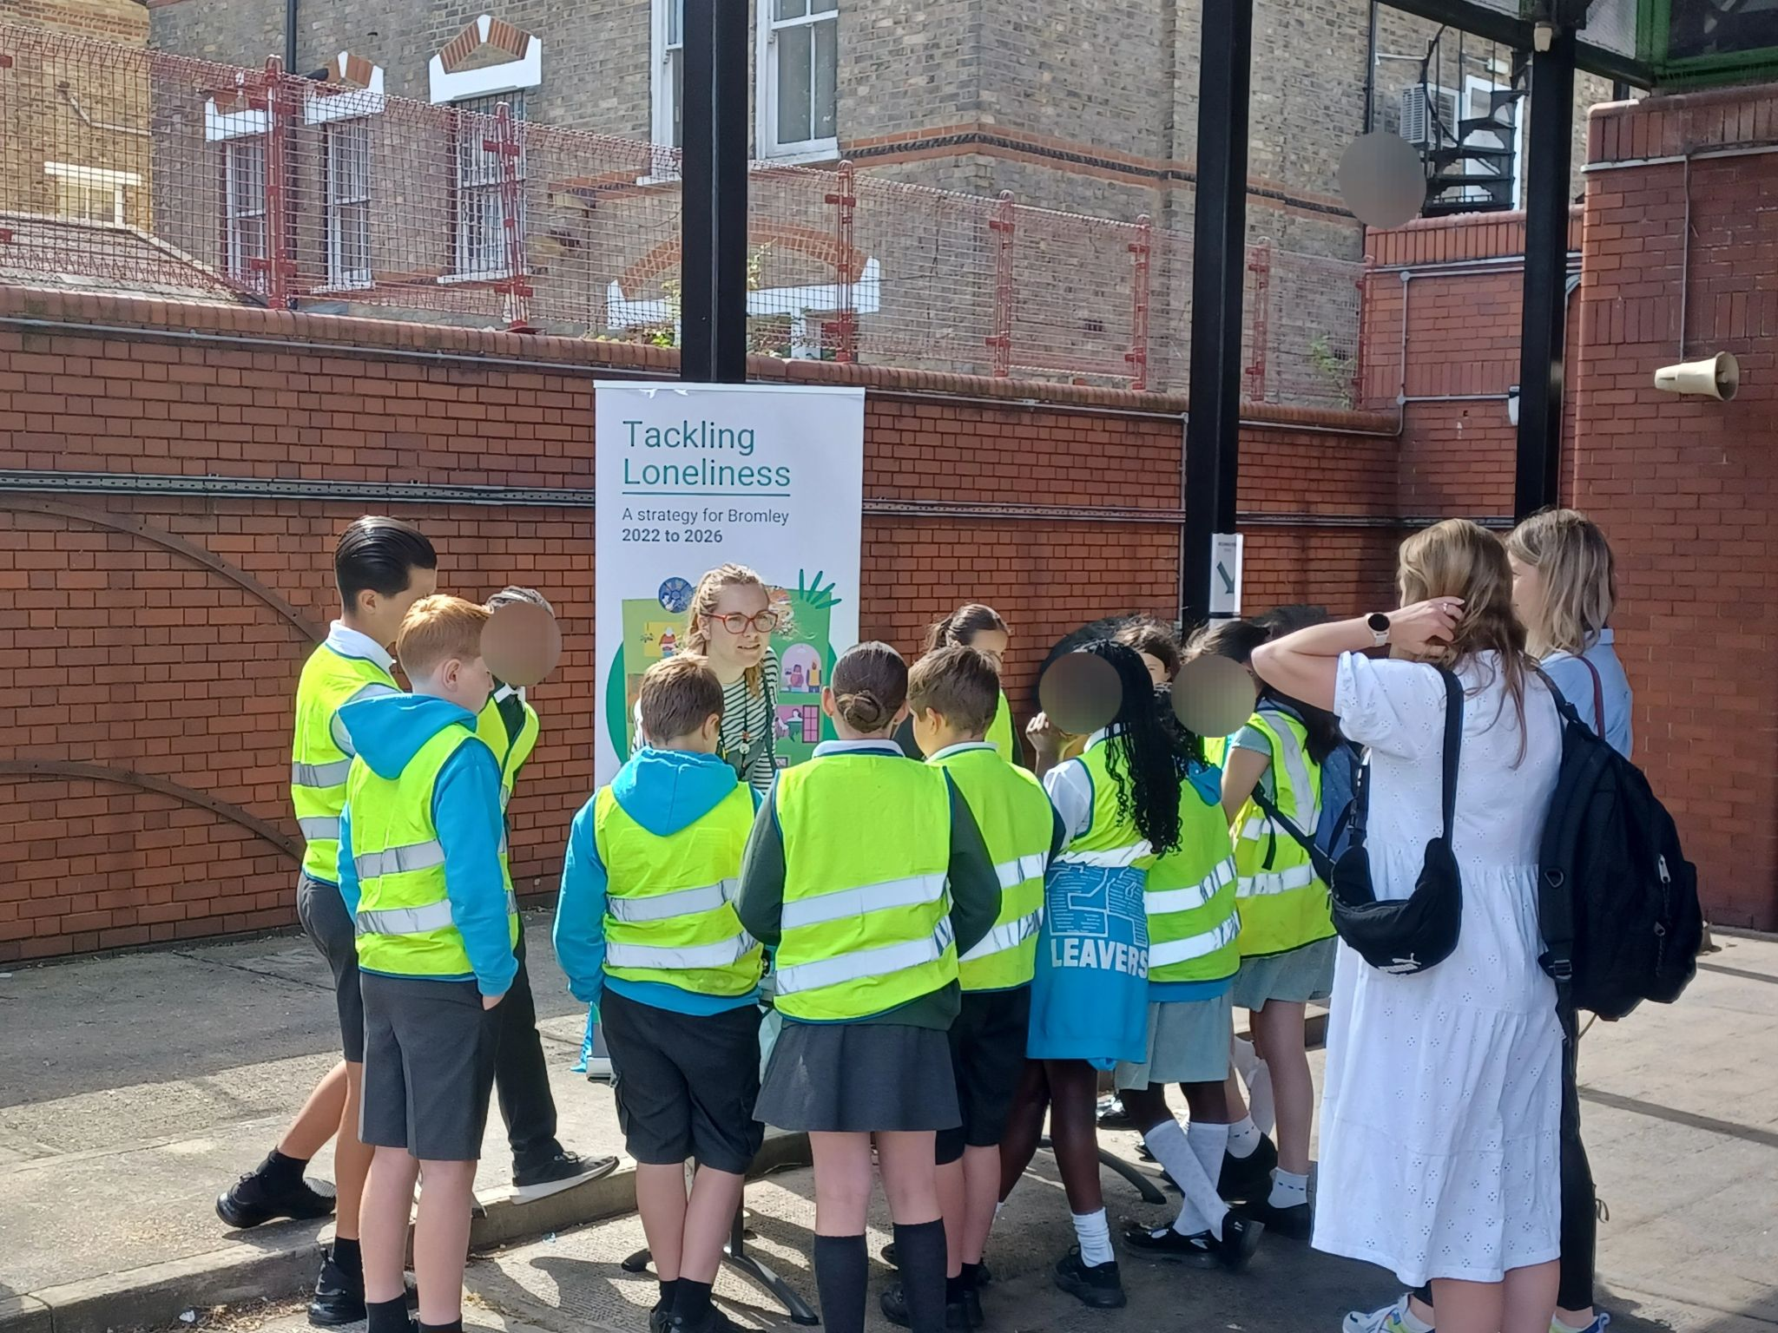
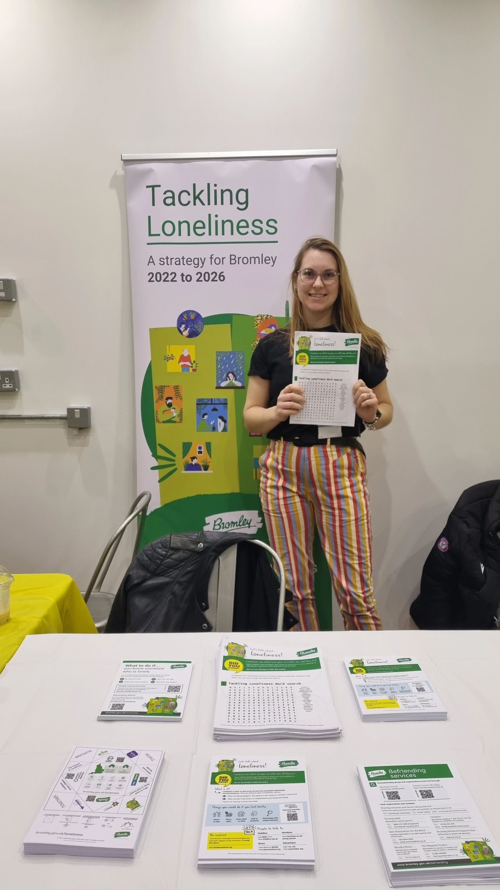
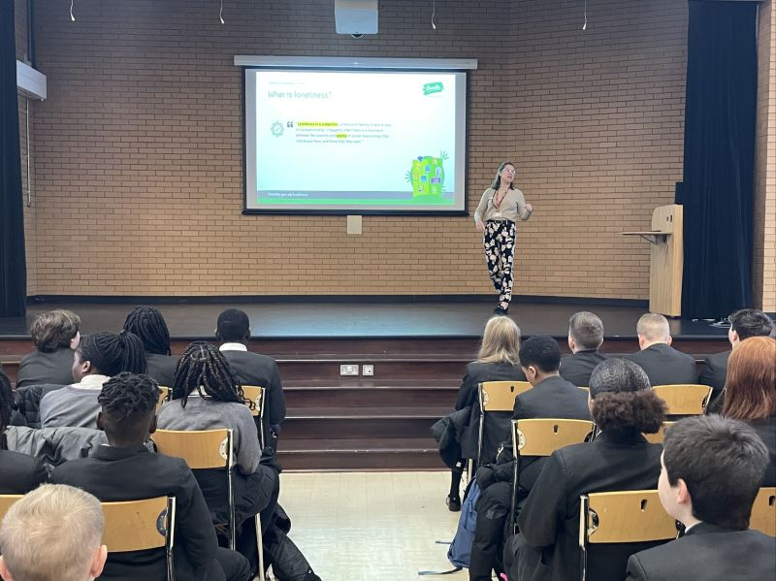
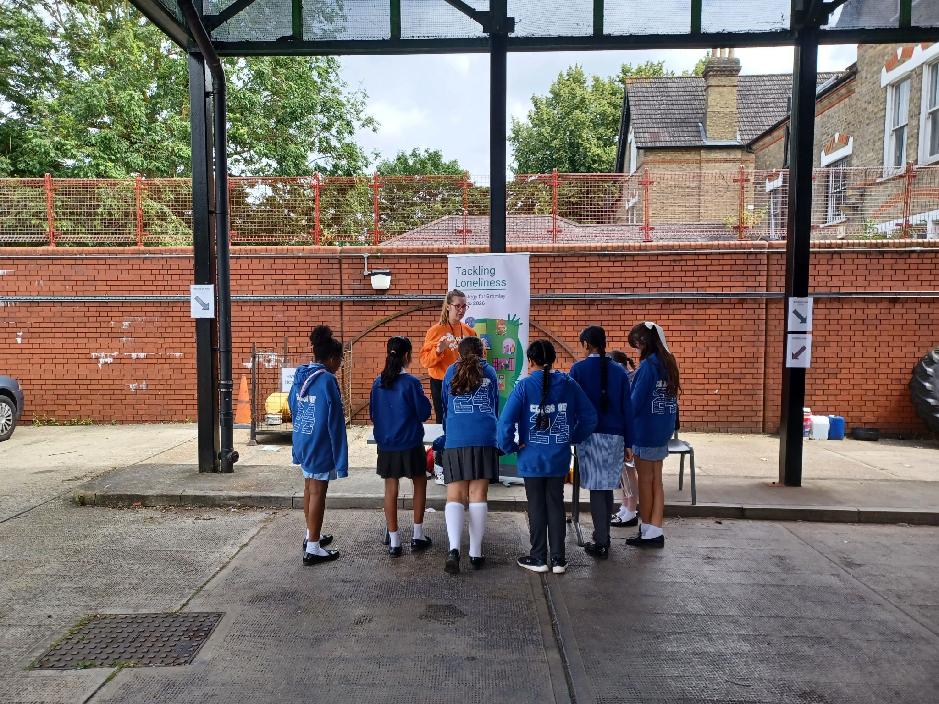
London Borough of Bromley, UK
Tackling Loneliness Strategy 2022 to 2026
Educating and supporting youth loneliness across Bromley
www.bromley.gov.uk/loneliness

Slide 9
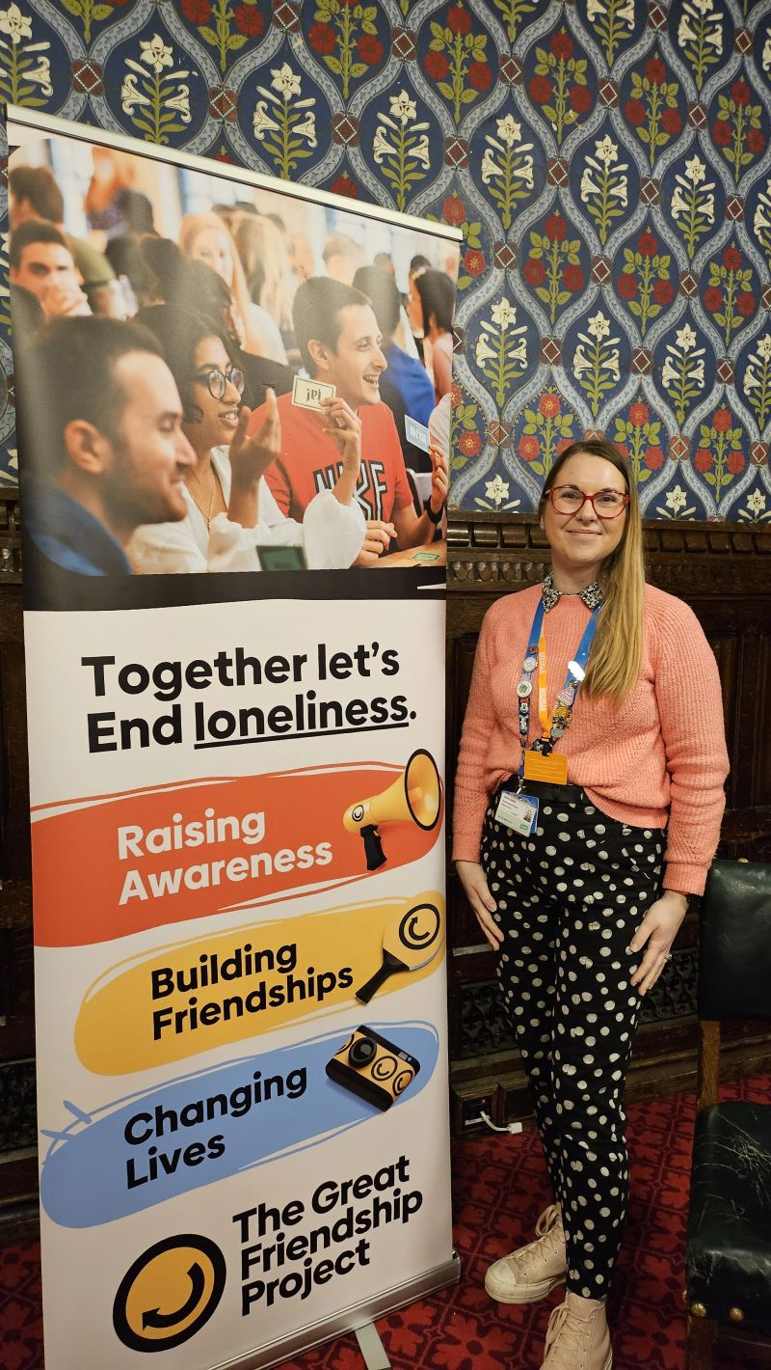
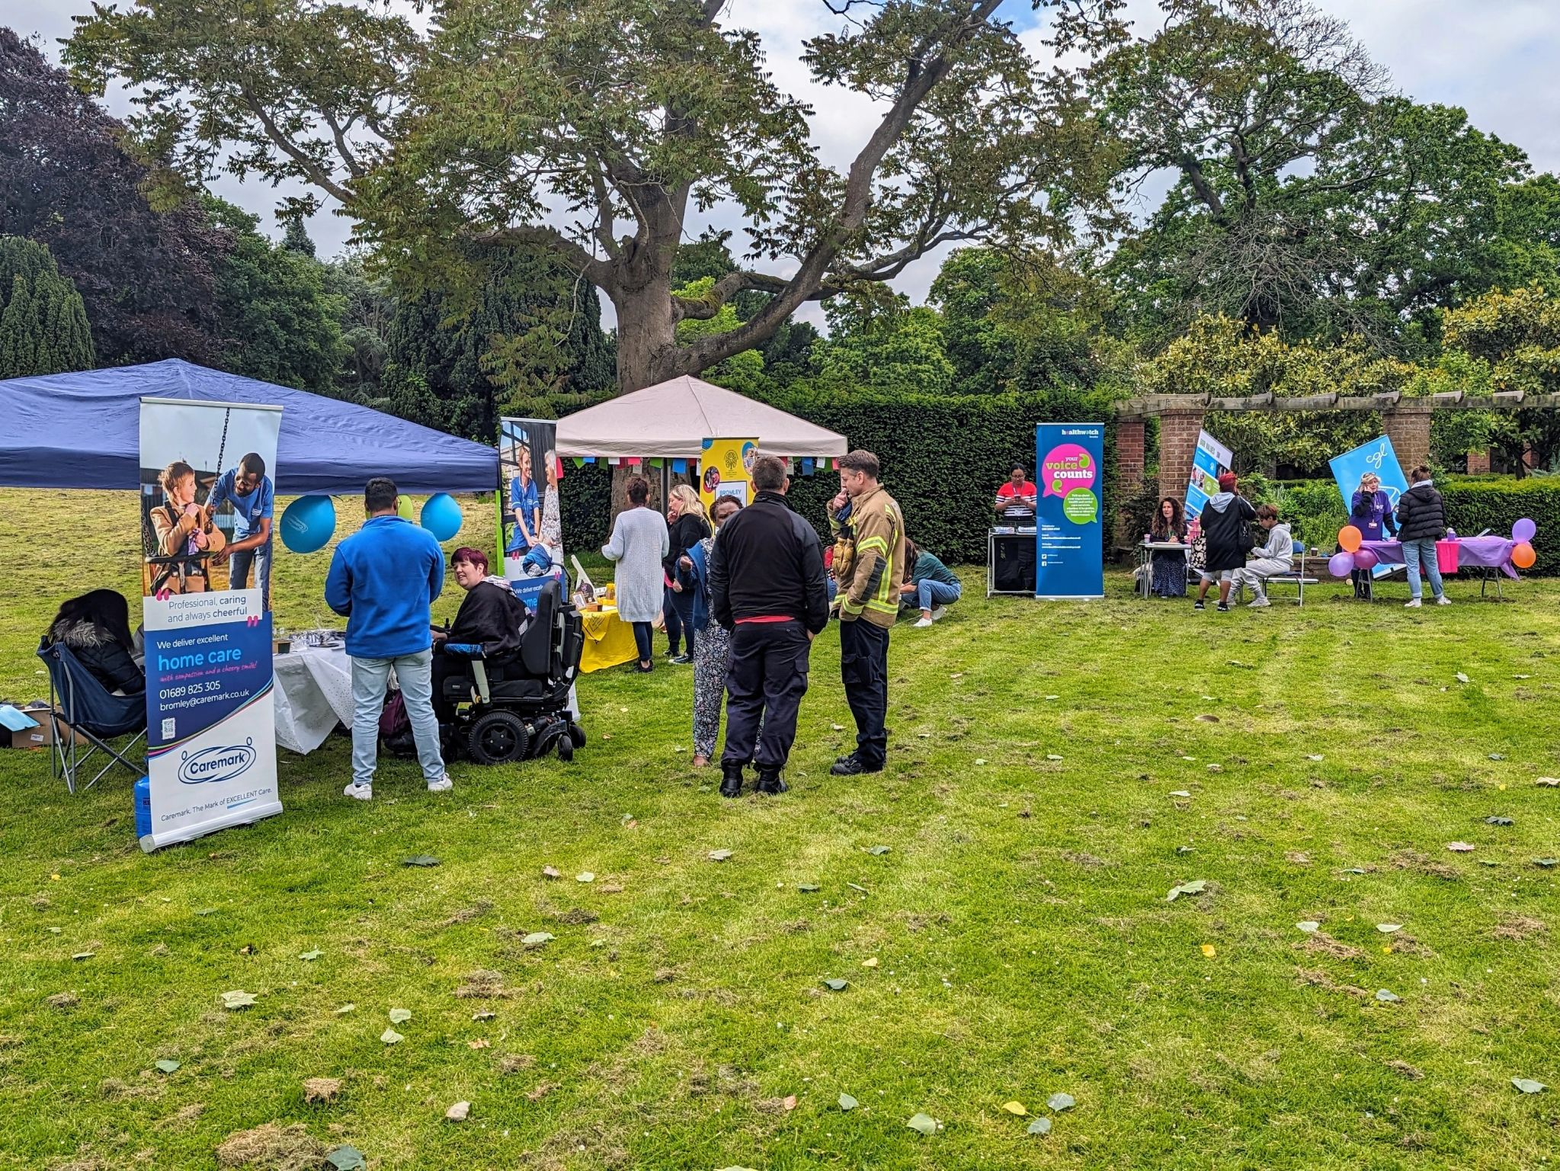
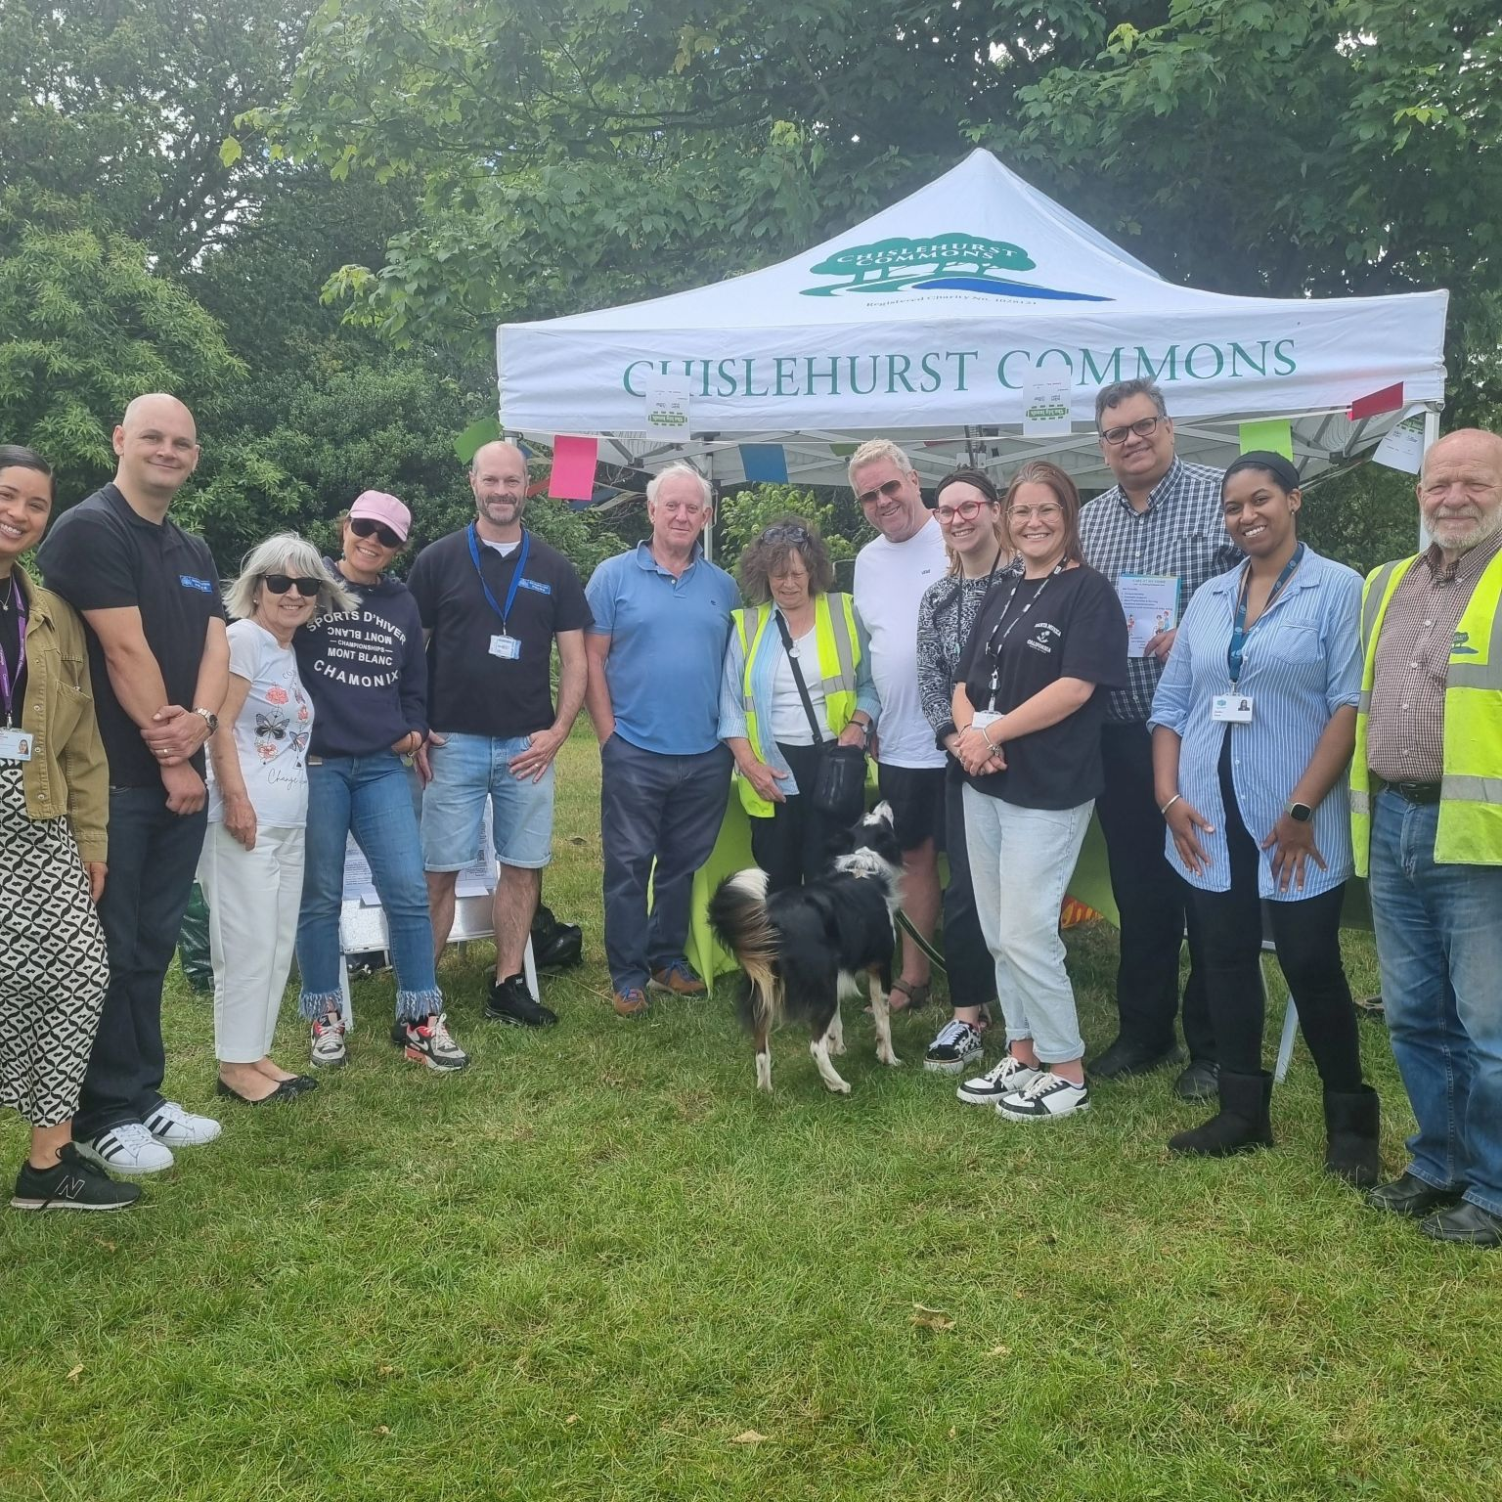
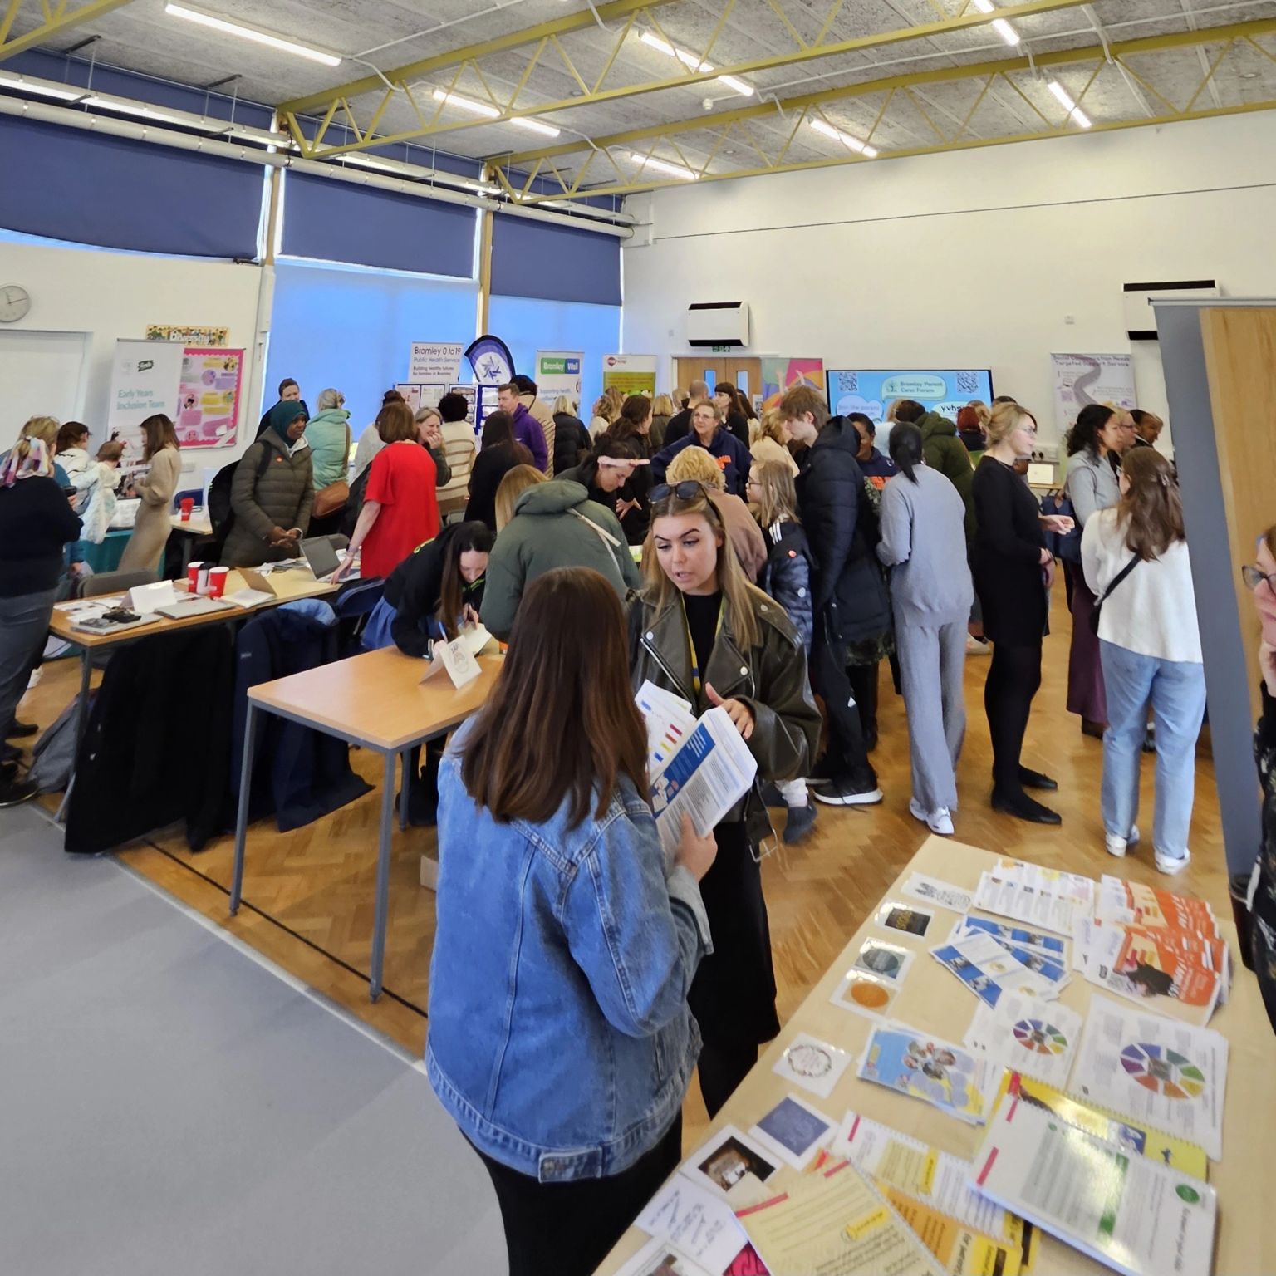
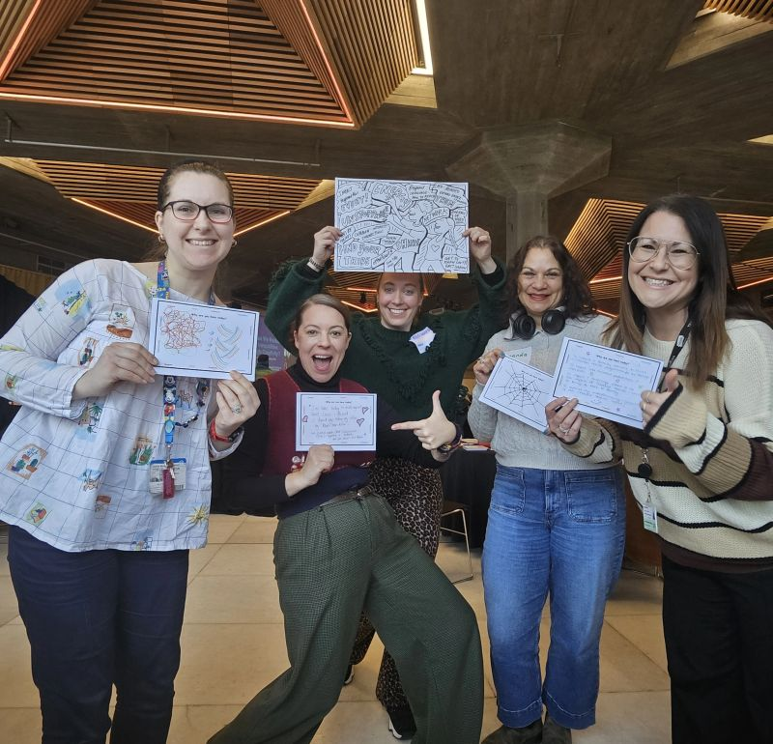
London Borough of Bromley, UK
Tackling Loneliness Strategy 2022 to 2026
Supporting people to find out what is happening in the community
www.bromley.gov.uk/loneliness

Slide 10

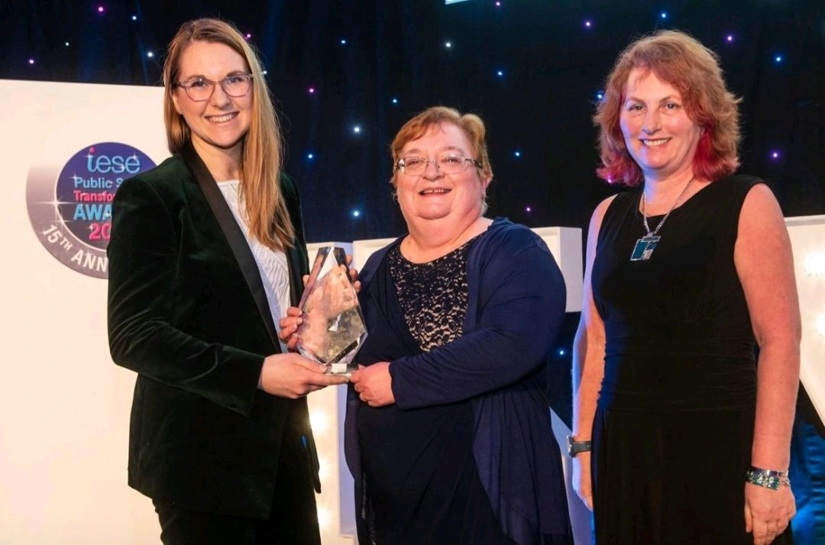
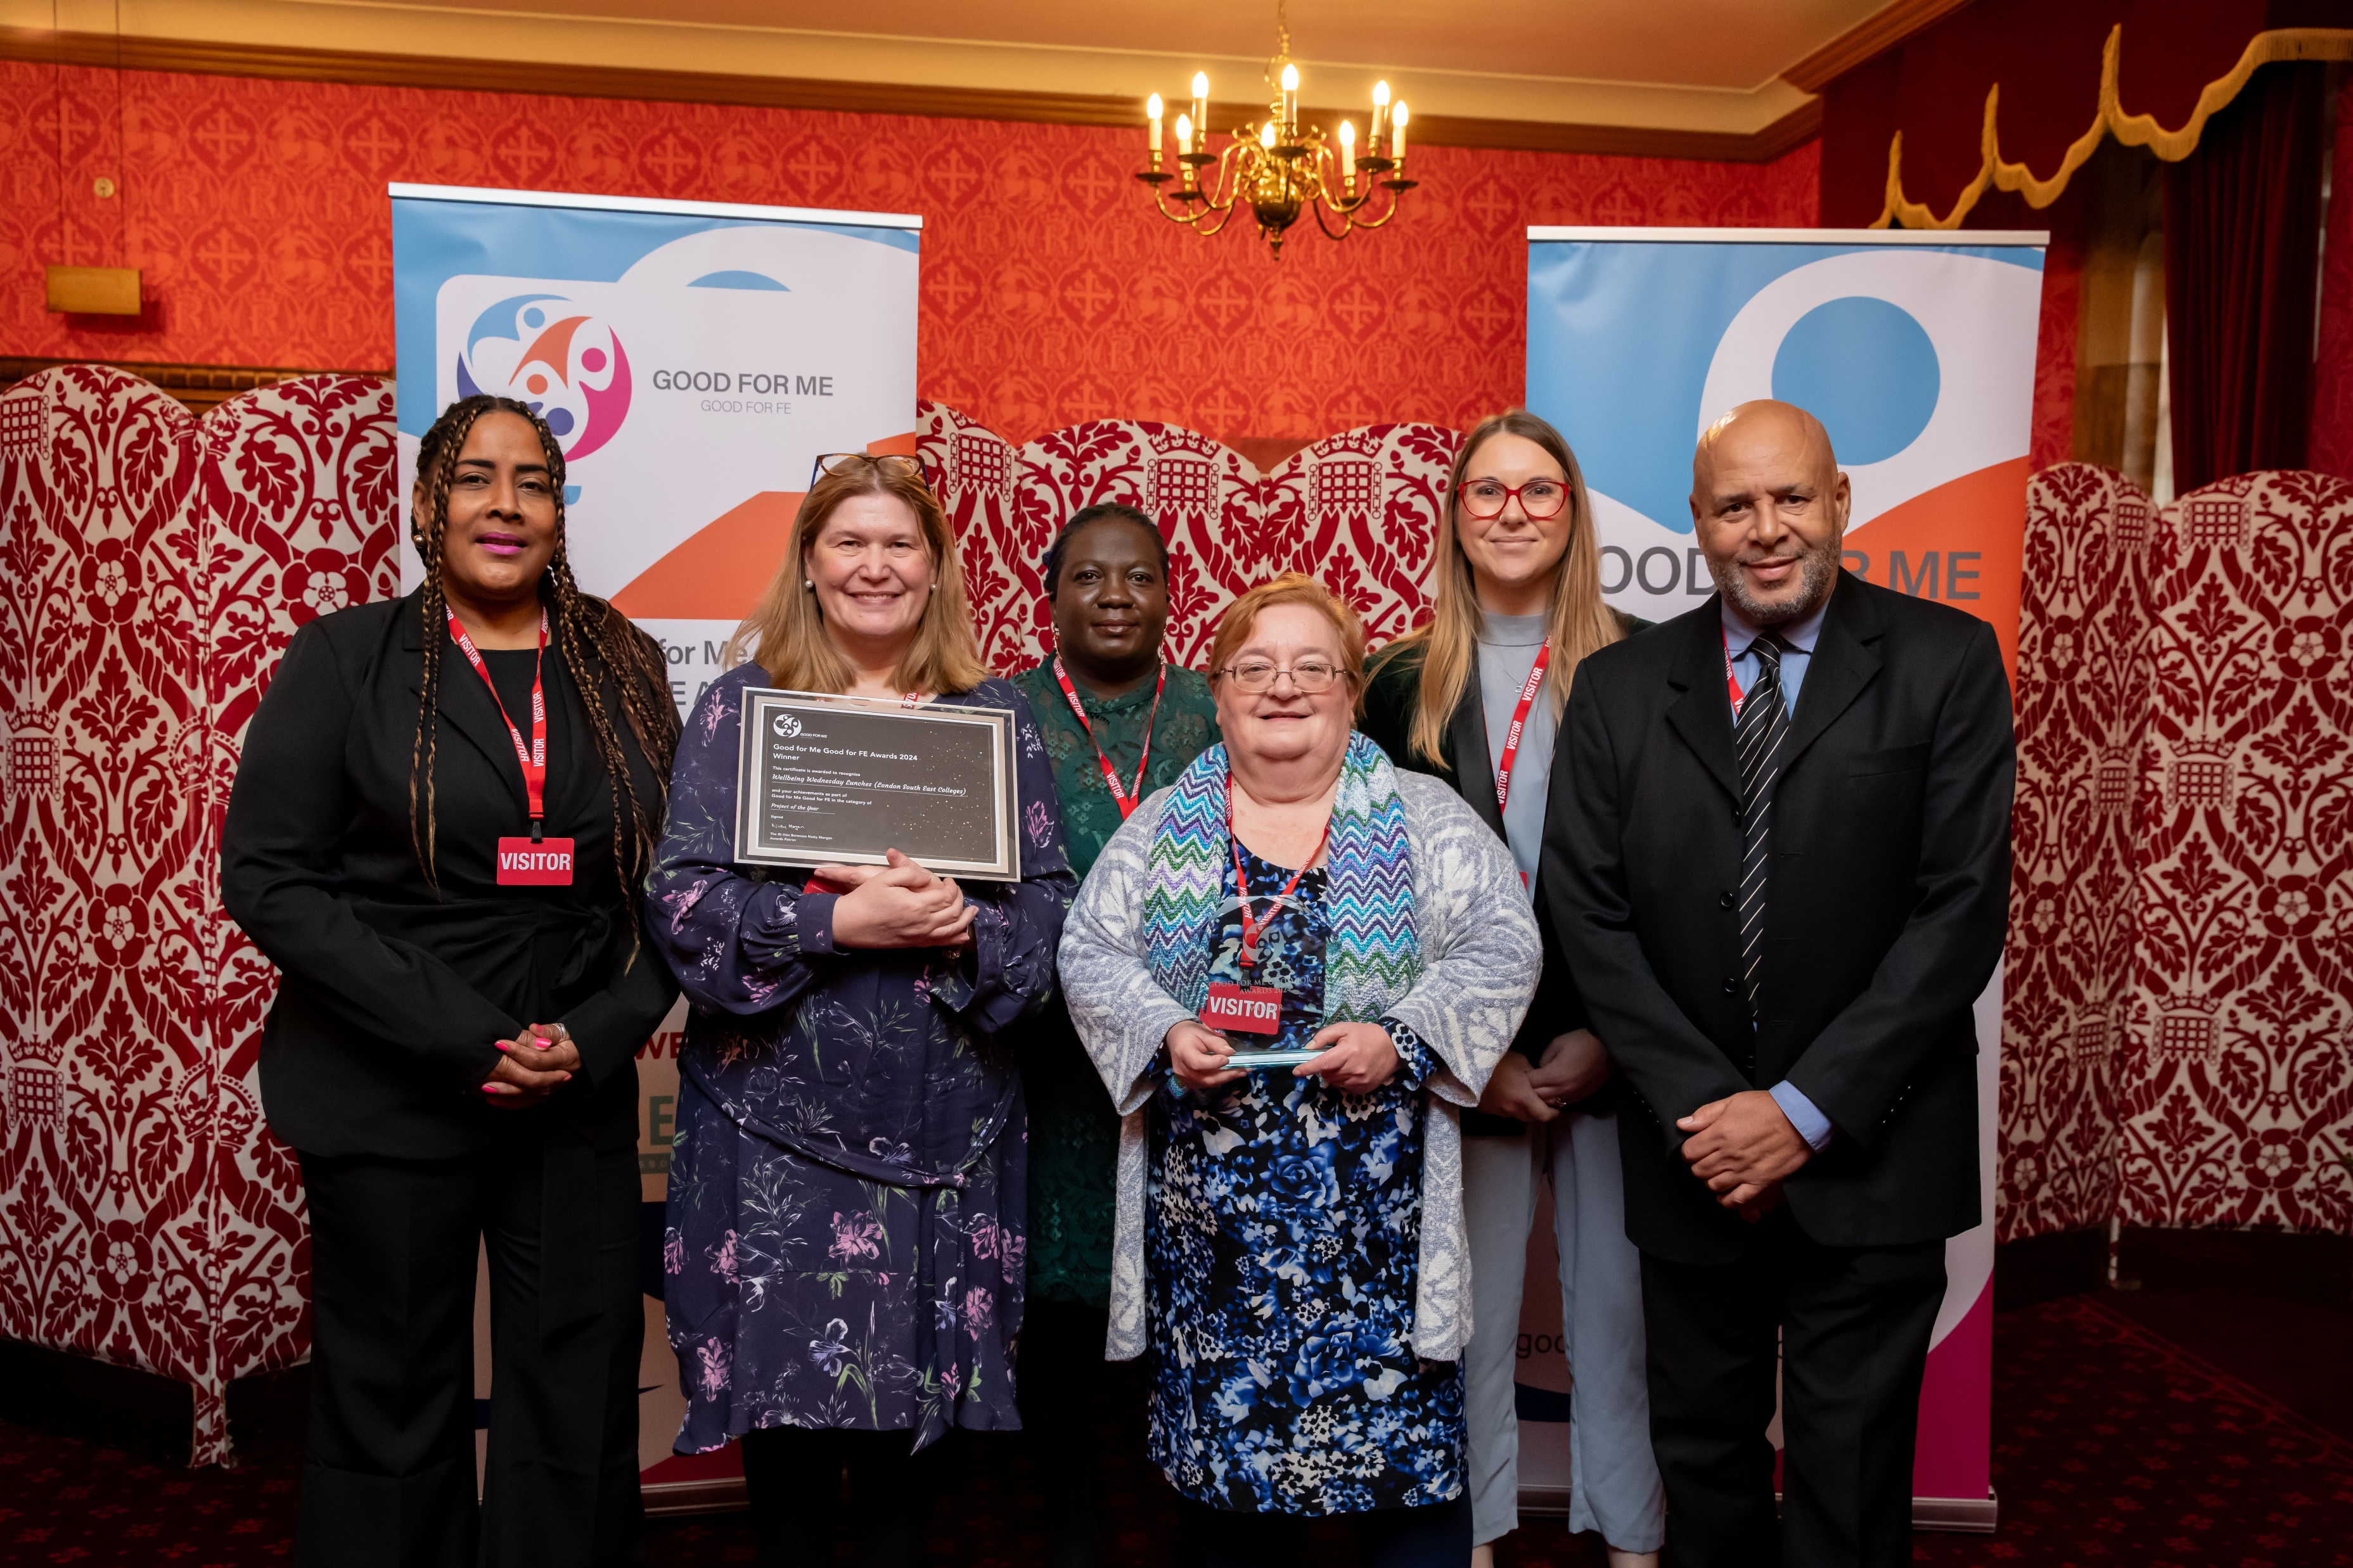

London Borough of Bromley, UK
Tackling Loneliness Strategy 2022 to 2026
iESE Gold Award winner
Good for Me, Good for FE award winner
www.bromley.gov.uk/loneliness

Slide 11






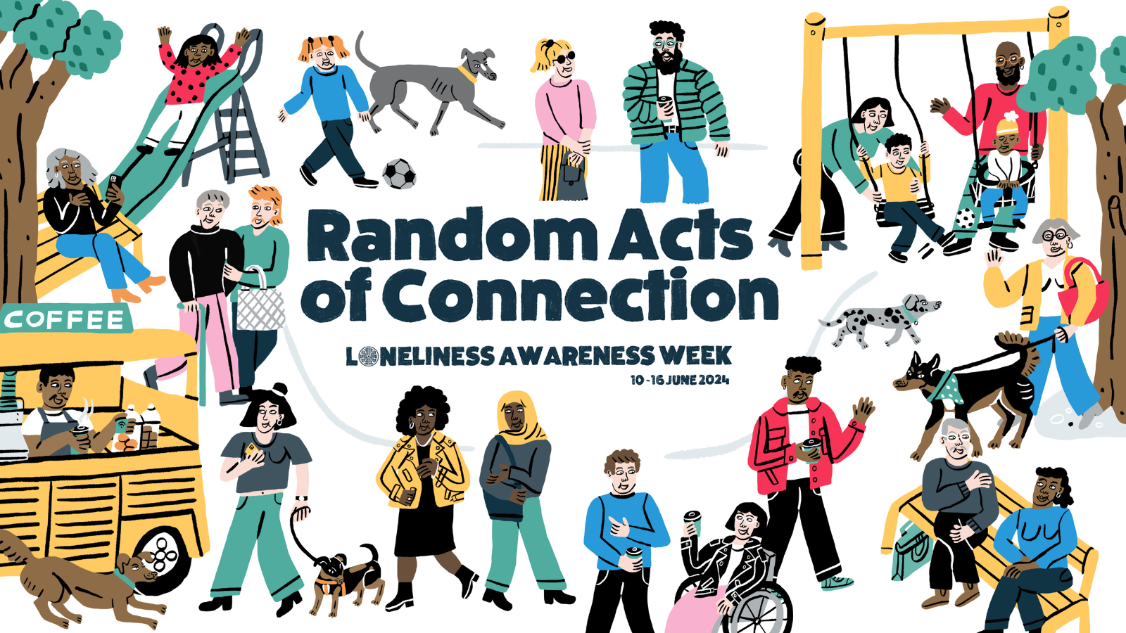



London Borough of Bromley, UK
Tackling Loneliness Strategy 2022 to 2026
Moving forward to create lasting change
www.bromley.gov.uk/loneliness

Slide 12
Thank you
Helayna Jenkins IEng
Principal Loneliness Champion
Strategy, Performance and Corporate Transformation
Helayna.jenkins@bromley.gov.uk
bromley.gov.uk/loneliness
bromley.gov.uk/loneliness

