Slide 1
Mental Health & Loneliness
Simone Bodholdt, CEO, Ventilen Danmark
Notes:
I just started as CEO in Ventilen in january. Before that I worked ten years at the Queen Mary Foundation building interventions and projects targeted young people feeling lonely.
I would like to disclaime that I’m not a reseacher but as Julie said we have in Ventilen 25 years of experience working with young people feeling severe loneliness. So my contribution is from a practitioner's perspective.
We’re are a grassroot movement and it is our young volunteers who also defines our strategies and the aims for our work.
So Ventilen is full of brilliant young people both volunteers and lonely young people.

Slide 2
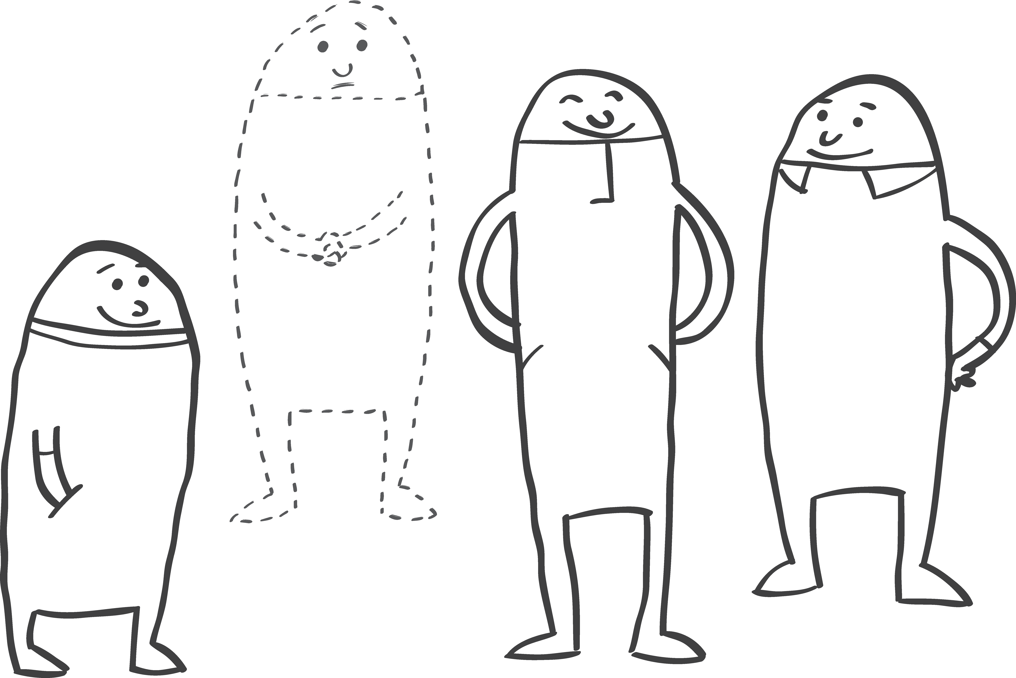
Talk in pairs
Tell your neighbor about a situation or period in your youth when you experienced loneliness
Notes:
Julie asked you earlier to think back on a situation or period when you remember feeling lonely. Julie shared her own story about moving to a new city at the age of 13.
Now, I want you to talk in pairs. Try to find someone you don't already know.
3 minutes.
---
Who here doesn’t remember feeling lonely at some point in their youth? Raise your hand, please.
Okay, most of you easily recalled a time or situation. So, we’ve established that loneliness is a normal, human experience we all know. Just like Jilie and Pamela said before.
But did you find it easy to talk about? And would it be more difficult to talk about current feelings?
Loneliness is a massive taboo, especially among young people.

Slide 3


"It's not easy to accept that you feel lonely, because you're almost telling yourself, 'you don't have any friends.' You've learned that it's a bit of a loser thing. Everyone has friends, and you don't hear about people who don't have any." (Markus)
"If I can’t have friends and a social life, I have failed as a human being.“ (Mathilde)
"I’m ashamed to admit that I’m a ‘background friend’. One who has many outward friends, but still ends up spending New Year’s Eve alone. I fear that I’m failing at being young.“
(Nina)
Notes:
I'll let the young people speak for themselves
Julie said it before: Loneliness challenge the ideal of youth – The ideal is to have a bunch of close friends, be social all the time, have fun… And if you dont have friends – real meaningful frienships – then you are not succeeding in one of the basic elements of a normal young persons life.
Then you are failing at being young. And then you hide it. You are embarresed and ashamed.
We can look at each other and say That’s terrible and not reality. But to the young people et feels very real.

Slide 4
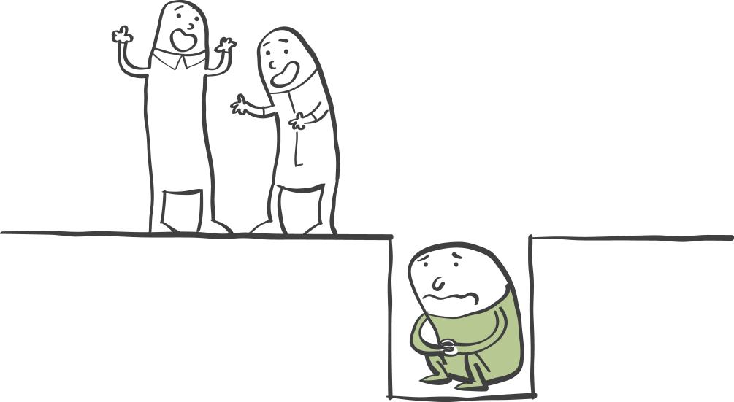
Shame is a problem because it prevents young people from reaching out for help
Notes:
And we want young people to reach out. Often, the feeling of loneliness is invisible, so the adults around them may not realize they are struggling.
I think it’s important to talk about shame because it’s one of the biggest barriers to seeking help. It’s crucial for the adults around the young person to understand what’s at stake.
At Ventilen, we often see young people take a long time before they show up and participate in activities at our clubs
For some, it takes years.
Pamela mentioned earlier that the feeling of loneliness should be seen as a positive one because it can lead to change. And it can, if we respond when it occurs.

Slide 5
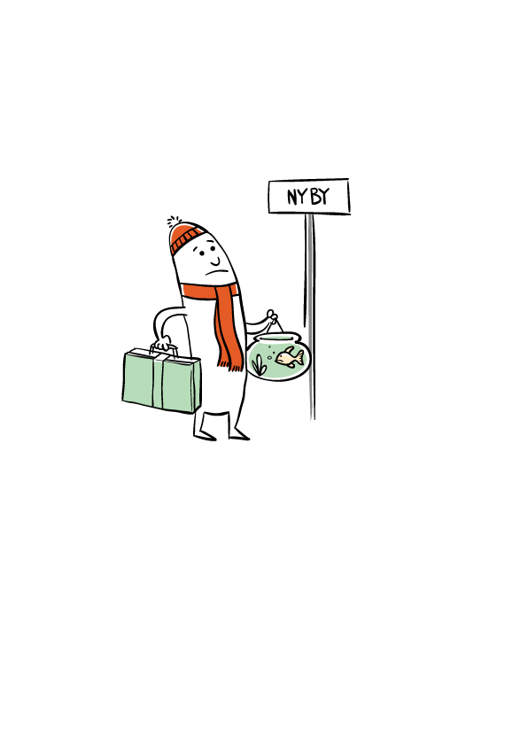

Short term
Long term
Shame
Fear of rejection
Acknowledgment
Notes:
But if we don’t respond or react, the feeling can stick.
As Julie mentioned the young people coming in Ventilen has experienced loneliness for a long time.
As you can se loneliness can be seen as a spectrum. And you can change direction many times on the way towards long term loneliness – reach out and seek help.
We see in Ventilen that the barriers to reaching out for help include shame, the fear of rejection, and the realization of the feeling of loneliness.
These are all thoughts. And important thoughts to know, if we want to understand why a young person feeling lonely doesn’t just ask for help.
This is also important because it helps us build better interventions.
----
Fear of rejection: Nobody likes me – I have been rejected so many time before, why would anyone want to hang out wirh me? – it’s easyer to turn down an invitation than show up and be dissapointed
Acknowledgement: I have to realize, that this terrible feeling I have inside actually is loneliness
----
Unge der føler sig ensomme over en længere periode er i højere risiko for misrtivsel og helbredsproblemer end unge der oplever mere forbigående former for ensomhed Kilde: van dulmen og Gossenes 2013

Slide 6


How does loneliness affect us?
Focus on the negative
Low self-esteem
Dismissive behavior
Thoughts
Poor social skills
Racing thoughts
Behavior
Social isolation & withdrawal
Stress hormones
Increased risk of cardiovascular diseases
Health
Concentration and sleep difficulties
Increased risk of mental health disorders
Notes:
There is no doubt that long-term loneliness affects the body and is harmful to health.
That is a massive and important issue for the individual and for society – and why we are here today learning from each other.
It is thoughts and behavior that keep us in the feeling – shame, fear of rejection, skepticism, distrust. The feeling becomes self-reinforcing.
The barriers are important to look at as a whole in order to find solutions.
In Ventilen we work focused to create a practice ground for young people, so they get better at forming social relationships
We make sure, that they have a common third – activities – so they can just show up.
Positive experiences make the young people believe more in themselves and make them feel valueble. In the end they begin to participate in activities with other young people – outside of Ventilen.
The young people need to practice being social together, and that’s why we work with them to help them change thought patterns and behavior.

Slide 7
“Ventilen made me less lonely! You don’t have to arrange a lot yourself – it’s nice that you can just show up. And there’s potential for you to grow because the people who come here all understand loneliness.” (Lukas)
”Before, I was the type of person who sat in the corner and didn’t say anything if I had to meet new people. Now, I’m much more talkative and open.” (Sofie)
”[In Ventilen] I realized that I
wasn't alone. It meant a lot to meet others who feel the same way. It has strengthened my self-esteem to know that I'm not alone in feeling lonely.” (Jens)
Notes:
Young people describing their development and benefits from attending Ventilen

Slide 8

Accessibility and facilitated communities
Knowledge, understanding, and targeted efforts
Safe spaces for building relationships
Show that you see the young person – and offer your support
Be kind and persistent
Activity as a method
              Remove barriers to participation
Notes:
1: makes it more safe to paticipate
2: Important to build social skills
3: Let the young person know that you see, that thay are struggling – make it clear that you’re trying to help and that yu are really interested in them
4: Long journey going back – don’t take no for an answer the first or second time
5: always think activities – common third – so that the young people know what to do and not are left to figure it out on their own – experiences from our clubs
6: fysical and mental – fx are everyone else coming aone or in pair? End point – not use energy on how long should I be here. It’s a big berrierer to them just to show up because theu have never succeded in a community before. We take it for granted that this is easy.
Vi arbejder målrettet med at indhente data fra vores unge, som kan fortælle, hvordan de ser løsninger.
Vi giver en stemme til de unge, som ellers ikke ville have sagt noget. Og hvis de skal pege på noget, så er det det her.
Noter fra dokumentationsrapport 2024 (interview), baseret på råd fra unge i Ventilen:
Vær nysgerrige på hinanden, sørg for at alle er inviteret og vær venligt vedholdne (et nej en gang er ikke lig med et nej 3. eller 4. gang)
Markus fra Ventilen beskriver, at der er mange spekulationer som går forud for at tage initiativ, så da han bliver spurgt hvad som gør det svært at tage initiatv til at ses med venner, svarer han: ”Det er jo nok meget det her med, at man er bange for, at de siger nej, eller at de måske ikke har lyst. Man vil ikke føle sig pressende. Så er det nemmere bare ikke at spørge, fordi så får ikke nogen afvisning. Men man skal lige huske at man heller ikke får et ja. Og det kan jo være, at de også sidder og venter” (Markus). Så vær nysgerrige og inviter hinanden.
Et råd fra en ung til en anden:
”Ræk ud. Selvom man døjer med noget svært, så prøv at ræk ud, og se om der ikke er et eller andet, man kan lave” (Jakob).
”Jeg vil minde dem om, at selvom det føles sådan, så er de ikke de eneste, der føler sig ensomme. Og af selvsamme grund er der andre, der også søger relationer, og så er det med at være lidt proaktiv med om at finde dem. Om det så er gennem fodbold, frivilligt arbejde eller et mødested. Det må de jo prøve af” (Markus).
”For mig har jeg opdaget, at hvis man er meget ærlig omkring sin situation, ”jeg føler sådan her og sådan her, de har negative følelser”. Det der med først at komme af med det, og så det med at spejle sig i andre” (Lukas)

Slide 9
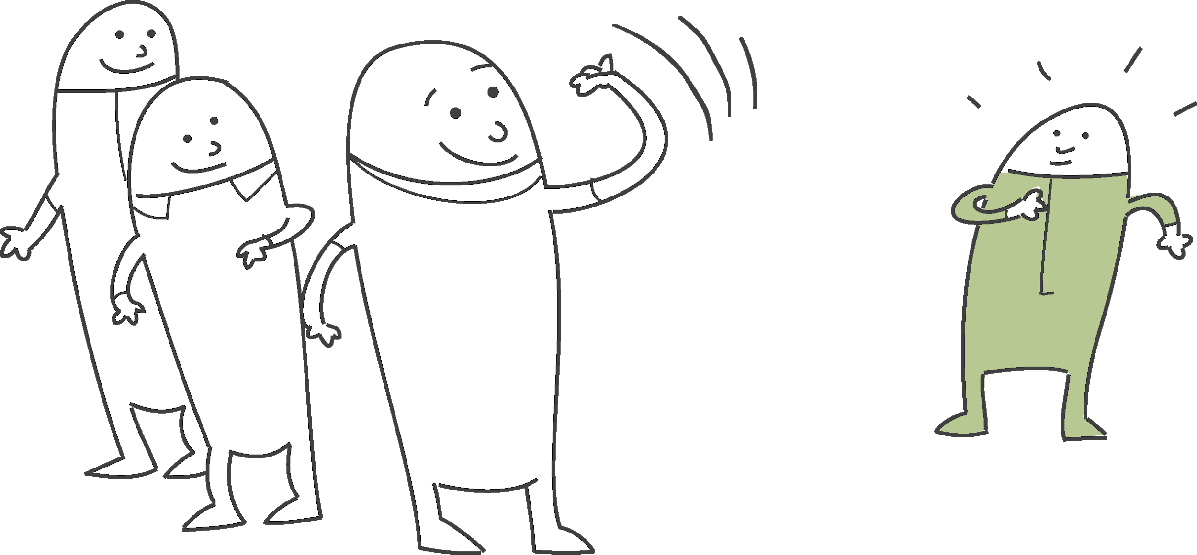
Final points
Shame and fear of rejection prevent young people from reaching out for help. We need to change thoughts
and behavior.
Think in a spectrum – there are several points on the way to long term loneliness where we can get
young people back on track.
The barriers are important to
look at as a whole
in order to find solutions.

